Slide 1
NUMBER SYSTEM
CLASS VII
CH-1 PERIOD -4

Slide 2
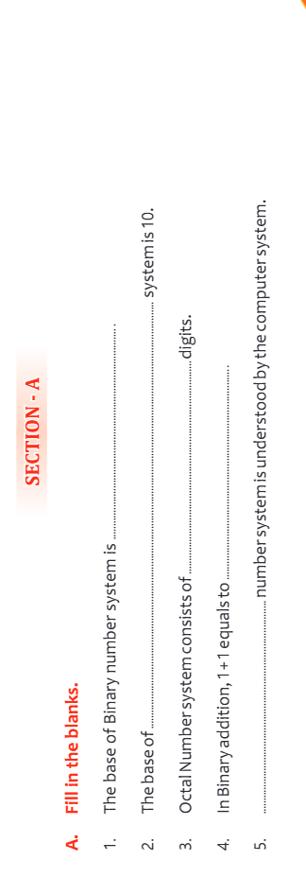

Slide 3
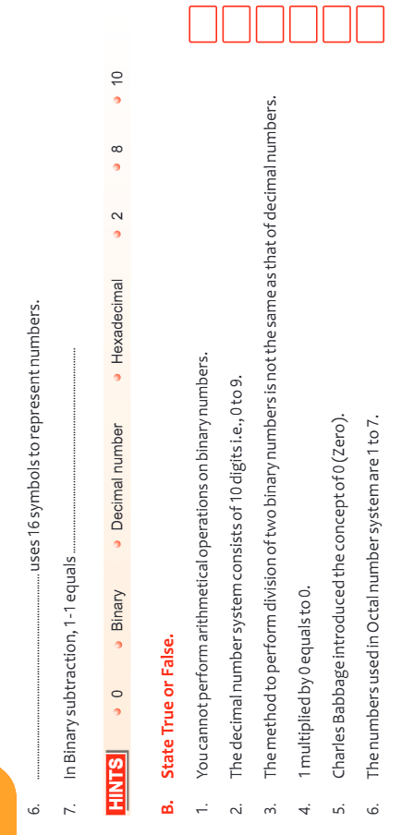

Slide 4
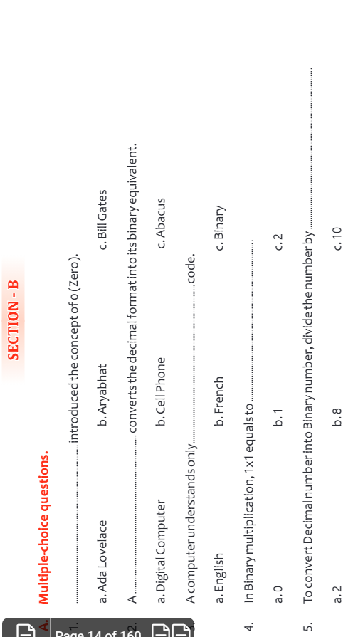

Slide 5
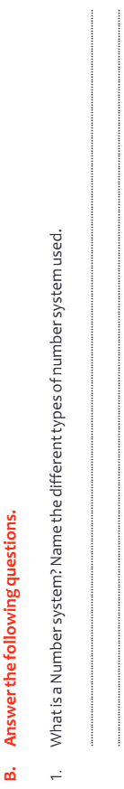
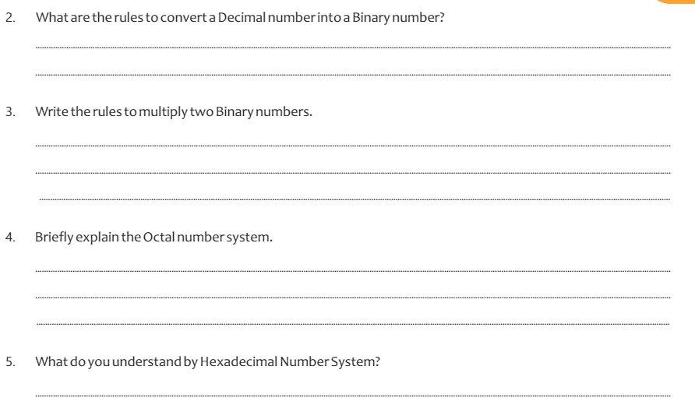

Slide 6

THANKING YOU
ODM EDUCATIONAL GROUP

