Slide 1

WELCOME TO ONLINE CLASS
CLASS : UKG
SUBJECT : ENGLISH
CHAPTER : 2 ( ‘n’ sound words)
TOPIC : Name the pictures.

Slide 2
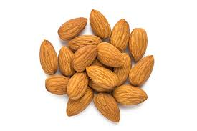
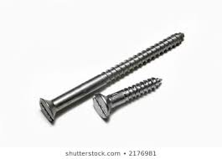
Lets identify the pictures and read
N
nails
nuts

Slide 3
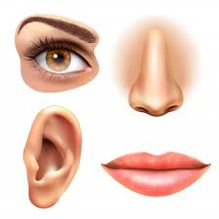

N
Nose
Net

Slide 4


N
newspaper
nurse

Slide 5
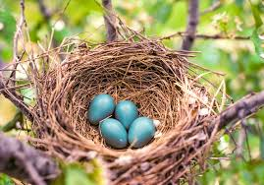

N
nine
nest

Slide 6

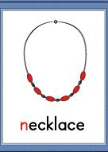
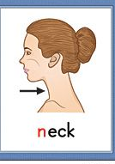

More ‘n’ sound words

Slide 7
CLASS ASSIGNMENT
(let’s do blending of the following words)
nut
net
nest
nap
not
nail

Slide 8
HOME ASSIGNMENT ( NAME THE PICTURES )

Slide 9
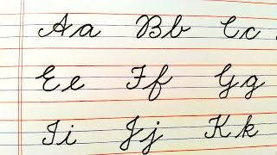

Let’s write cursive
cw
10.05.21

Slide 10

THANKING YOU
ODM EDUCATIONAL GROUP

