Slide 1

WELCOME TO THE ONLINE CLASS
CLASS-UKG
SUBJECT-MATHS
TOPIC- NUMBERS (21 TO 50)
ACTIVITY

Slide 2
LET’S COUNT NUMBERS FROM 21 TO 50
45
21
27
33
39
34
46
22
28
40
23
29
35
41
47
24
30
36
42
48
37
43
49
25
31
26
32
38
44
50

Slide 3



Count 21 to 30 written on each shape and help the butterfly to reach to the flower.
21
32
22
19
45
23
43
15
24
30
25
26
29
34
28
45
27
40

Slide 4


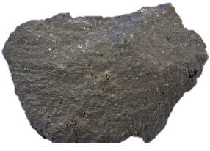
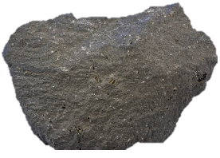
LET’S COUNT NUMBERS FROM 41 TO 50
Pingoo will jump on the rocks
By counting 41 to 50
48
49
50
43
44
45
46
47
42
41

Slide 5
COUNT 31 TO 40 AND ENCIRCLE THE NUMBERS.
18
40
36
35
10
31
37
45
38
25
17
19
34
33
45
39
32

Slide 6

THANKING YOU
ODM EDUCATIONAL GROUP

