Slide 1

WELCOME TO THE ONLINE CLASS
CLASS-UKG
SUBJECT-MATHS
TOPIC- BK PG 40
NUMBERS (21 TO 50)

Slide 2

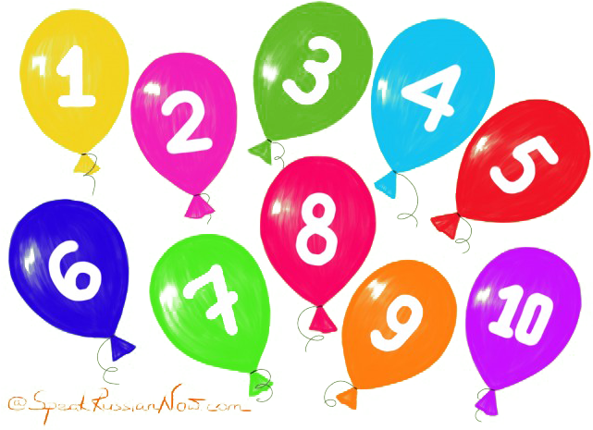
LET’ RECAP: (1 TO 20)

Slide 3


11
13
12
14

Slide 4
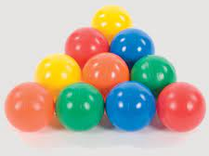
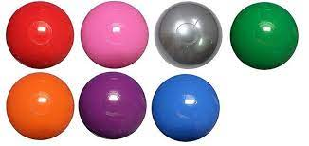
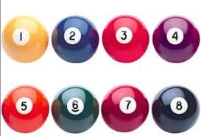
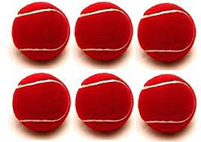
15
17
18
16

Slide 5
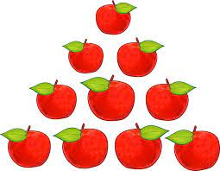
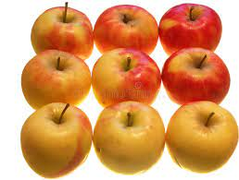
19
20

Slide 6
LET’S COUNT NUMBERS FROM 21 TO 50
45
21
27
33
39
34
46
22
28
40
23
29
35
41
47
24
30
36
42
48
37
43
49
25
31
26
32
38
44
50

Slide 7






FUN TIME
Observe the numbers written on each balloon.
29
21
34
48
50
36

Slide 8
Guess the numbers written on each balloon.
2 _
9
_1
2
3_
4
8
4 _
50
_ _
_ 6
3

Slide 9

THANKING YOU
ODM EDUCATIONAL GROUP

