Slide 1

WELCOME TO ON LINE CLASS
CLASS-UKG
SUBJECT-MATHS
TOPIC-COUNT AND CIRCLE THE
CORRECT NUMBER
(BK PG 39)

Slide 2
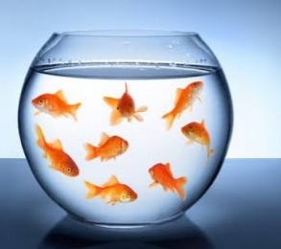

count and choose the correct option
8
Great Job!
10
Try Again

Slide 3
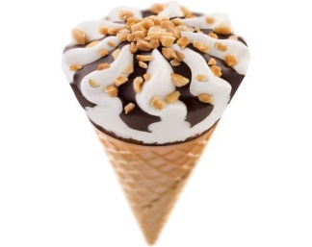
count and choose the correct option
13
Try Again
14
Great Job!

Slide 4

COUNT AND COLOUR THE CORRECT ANSWER
18
14
13

Slide 5
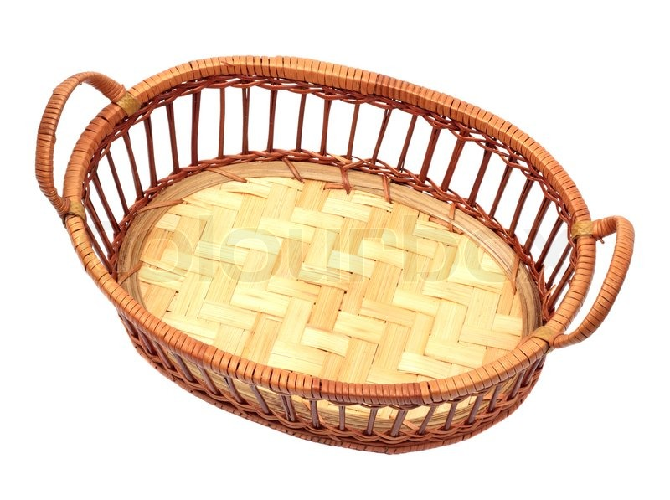

COUNT AND COLOUR THE CORRECT ANSWER
14
12
15

Slide 6
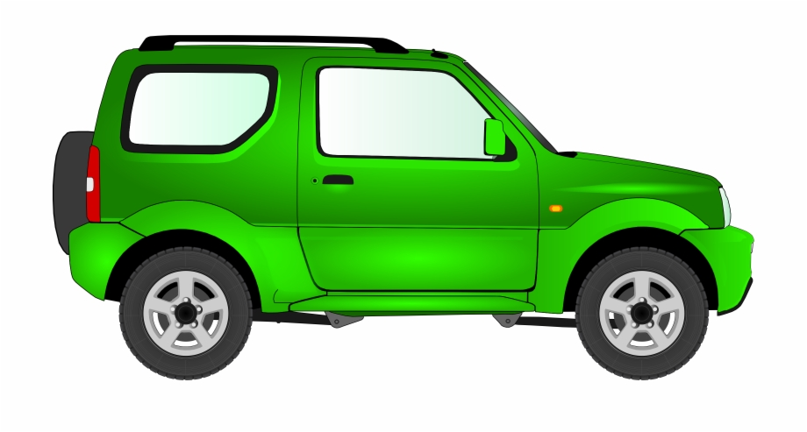

COUNT AND CIRCLE THE CORRECT NUMBER
17
14
20

Slide 7
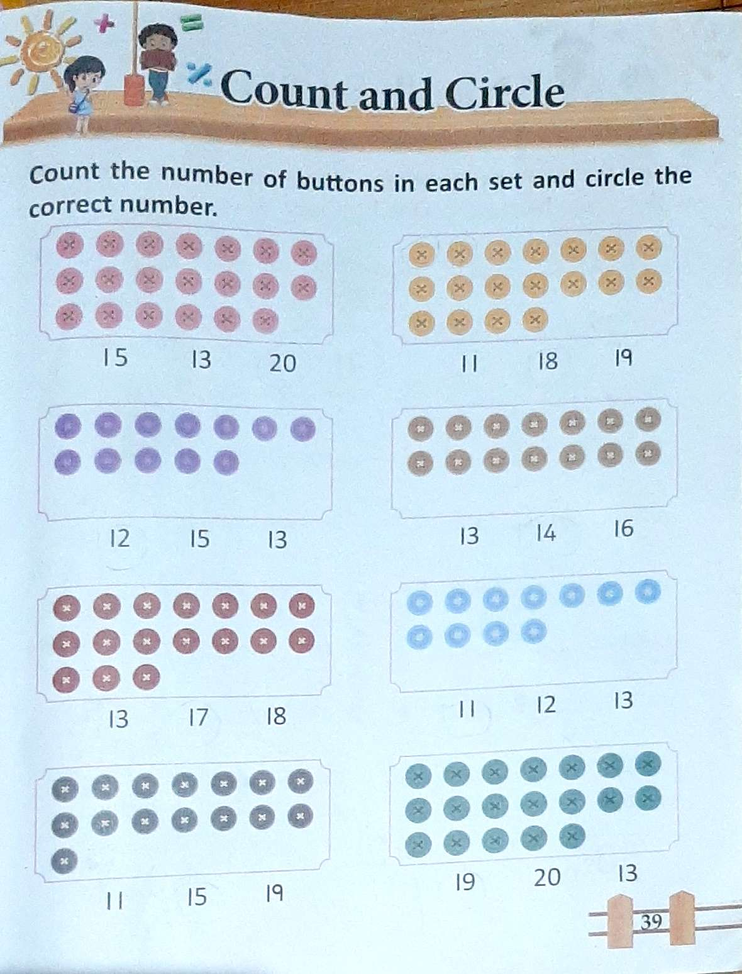
CW
30/6/21
BK PG 39

Slide 8

THANKING YOU
ODM EDUCATIONAL GROUP

