Slide 1

WELCOME TO ON LINE CLASS
CLASS-UKG
SUBJECT-MATHS
TOPIC- NUMBER AND NUMBER
NAMES 21-50(ONCE AGAIN)
(DATE-26.7.21)

Slide 2

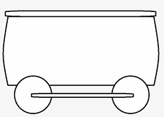















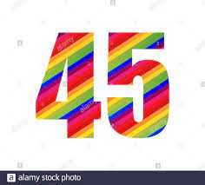
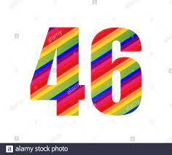

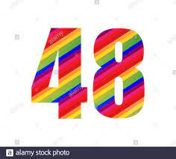
Count forward and say the missing numbers:

Slide 3



Count and say the number and the number names:
36
Thirty six
30
Thirty
27
Twenty seven

Slide 4

Choose the correct number name and say:
34
Thirty four
Forty nine
Thirty four
49
Forty nine
Eighteen
Forty eight
Forty six
23
Twenty three
Thirty six
Fifty
Twenty three
48
Forty eight
Twenty
36
Thirty six

Slide 5
Class assignment: Write the numbers 21 to 50 under TO
26/7/21
T | O |  | T | O |  | T | O
2 | 1 |  |  |  |  | 4 | 1
 |  |  | 3 | 2
2 | 4 |  |  |  |  | 4 | 4
 |  |  | 3 | 6
2 | 7
 |  |  |  |  |  | 4 | 8
 |  |  | 3 | 9
3 | 0 |  |  |  |  | 5 | 0

Slide 6

THANKING YOU
ODM EDUCATIONAL GROUP

