Slide 1

WELCOME TO ON LINE CLASS
CLASS-UKG
SUBJECT-MATHS
TOPIC- NUMBER AND NUMBER
NAMES 21-50

Slide 2
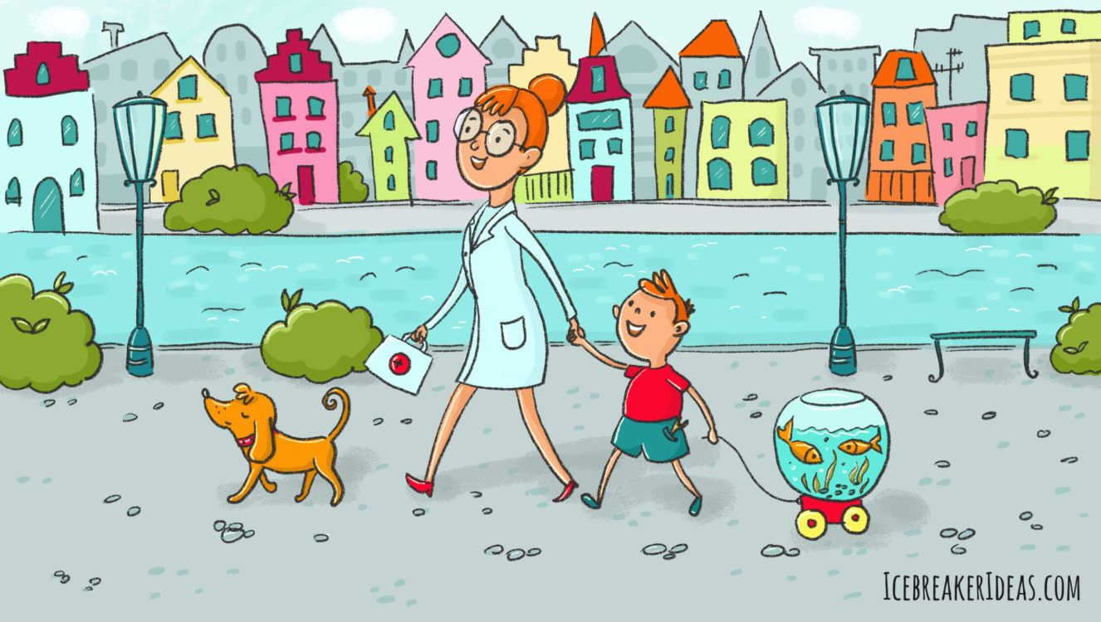
Find the hidden number names and say:
Thirty five
Twenty one
Thirty five
Forty eight
Twenty one
Thirty
Forty
Thirty
Thirty three
Forty eight
Thirty seven
Thirty nine
Forty
Thirty three
Thirty seven
Twenty nine

Slide 3




Unscrambled the number names:
e
T
y
e
T
w
n
e
o
F
t
y
r
n
t
f
u
r
o
t
s
v
e
n
e
F
o
r
t
y
s
e
v
e
n
o
u
e
o
u
r
e
n
n
r
n
f
T
y
f
T
T
y
T
w
t
F
r
o
t
y
t
w
t
o
T
i
r
h
y
t
F
o
r
t
y
t
w
o
f
v
i
e
T
h
i
r
t
y
f
i
v
e

Slide 4
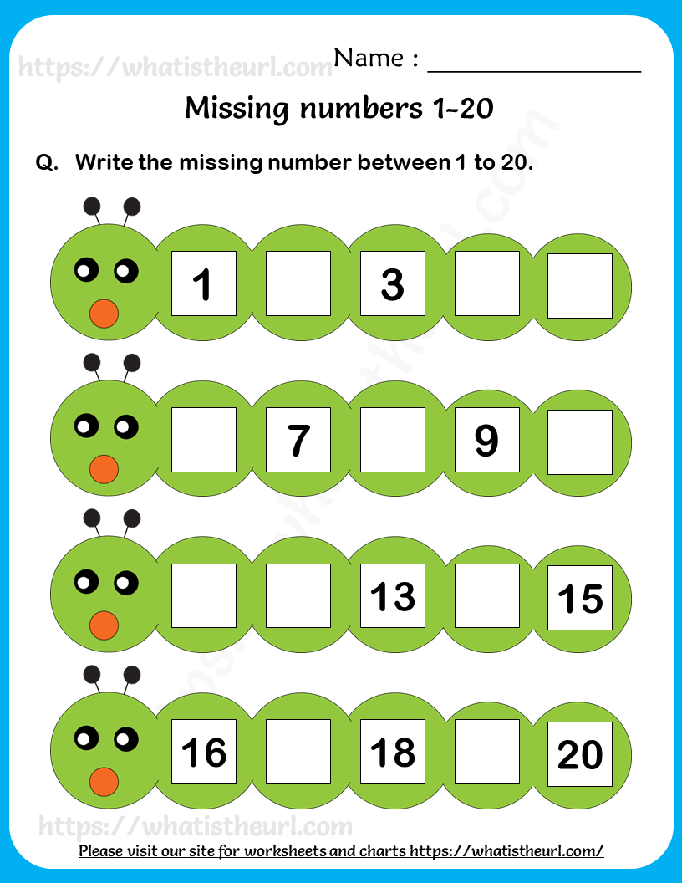
C/W
22/7/21
Count forward and write the missing numbers:
25
27
33
35
45
47
45
47
49

Slide 5
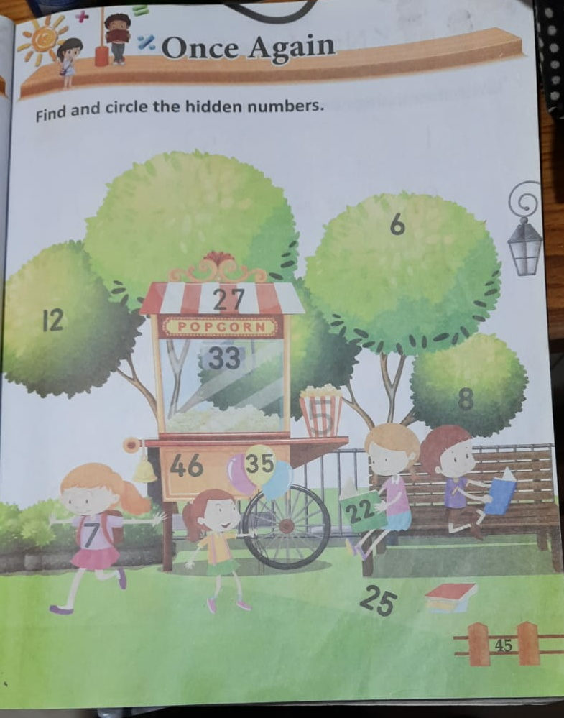
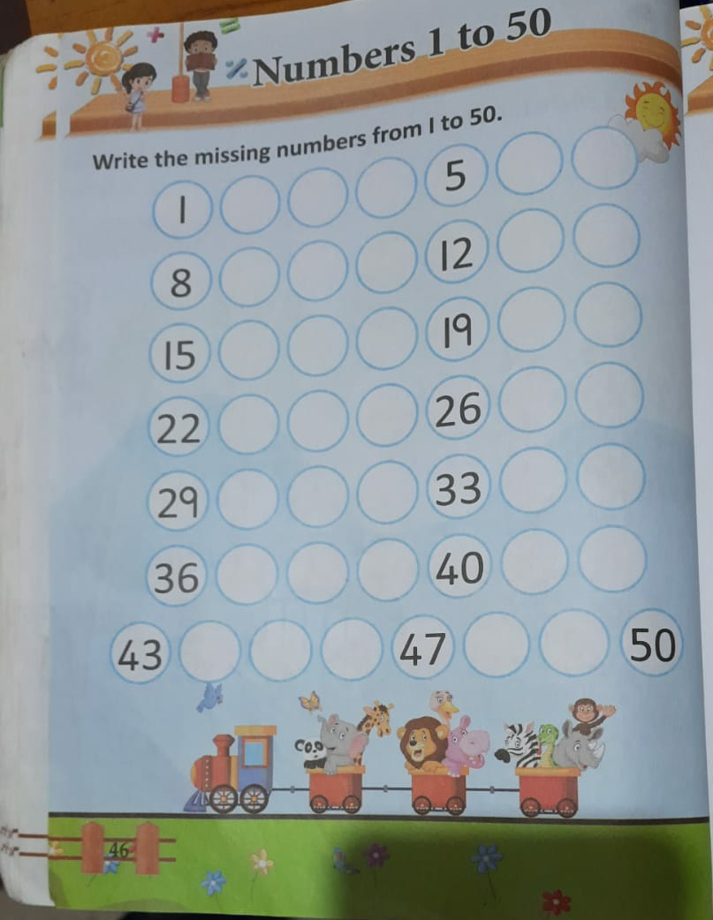

Slide 6

THANKING YOU
ODM EDUCATIONAL GROUP

