Slide 1

WELCOME TO ON LINE CLASS
CLASS-UKG
SUBJECT-MATHS
TOPIC- NUMBER AND NUMBER
NAMES 21-50(ONCE AGAIN)

Slide 2
Fill in the missing numbers from 1 to 50:
1
2
3
4
5
6
7
8
9
10
11
12
13
14
15
16
17
18
19
20
21
22
23
24
25
26
27
28
29
30
31
32
33
34
35
36
37
38
39
40
41
42
43
44
45
46
47
48
49
50

Slide 3

Identify the correct numbers according to their number names:
Twenty seven
28
27
Thirty three
33
43
Seventeen
18
17
Forty nine
29
49
49
Thirty eight
38
28

Slide 4
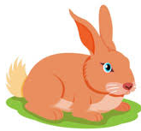

Count 21 to 30 and help the rabbit to get the carrot:
21
22
11
12
13
14
15
16
23
17
18
19
9
10
31
32
24
45
12
43
40
34
35
25
26
27
42
30
41
43
44
47
28
6
33
45
8
49
48
49
29
30

Slide 5





Count and match the following:
35
Thirty
30
Twenty five
Thirty five
25

Slide 6
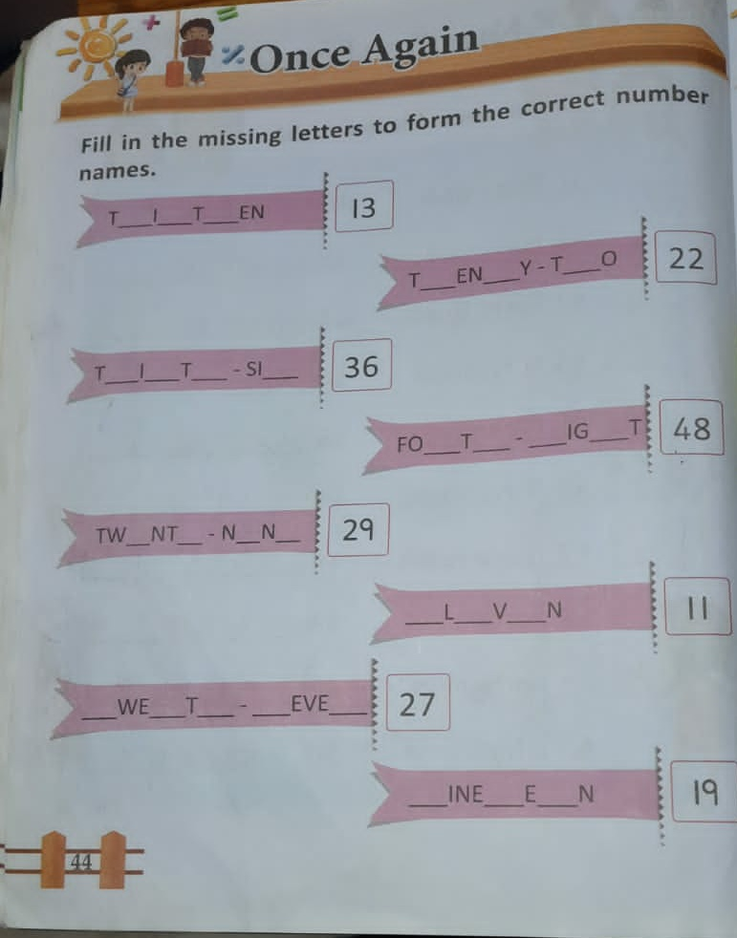
C/W
DT-20.7.21

Slide 7

THANKING YOU
ODM EDUCATIONAL GROUP

