Slide 1

WELCOME TO ONLINE CLASS
CLASS-UKG
SUBJECT-RHYME
TOPIC-BACKWARD COUNTING

Slide 2
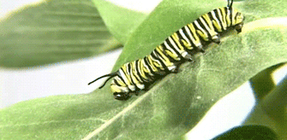

Slide 3



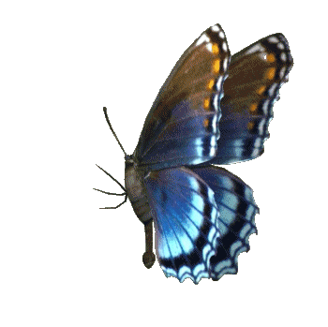


Slide 4



Slide 5

THANKING YOU
ODM EDUCATIONAL GROUP

