Slide 1

WELCOME TO THE ONLINE CLASS
CLASS-UKG
SUBJECT-FOOD
TOPIC- ACTIVITY

Slide 2
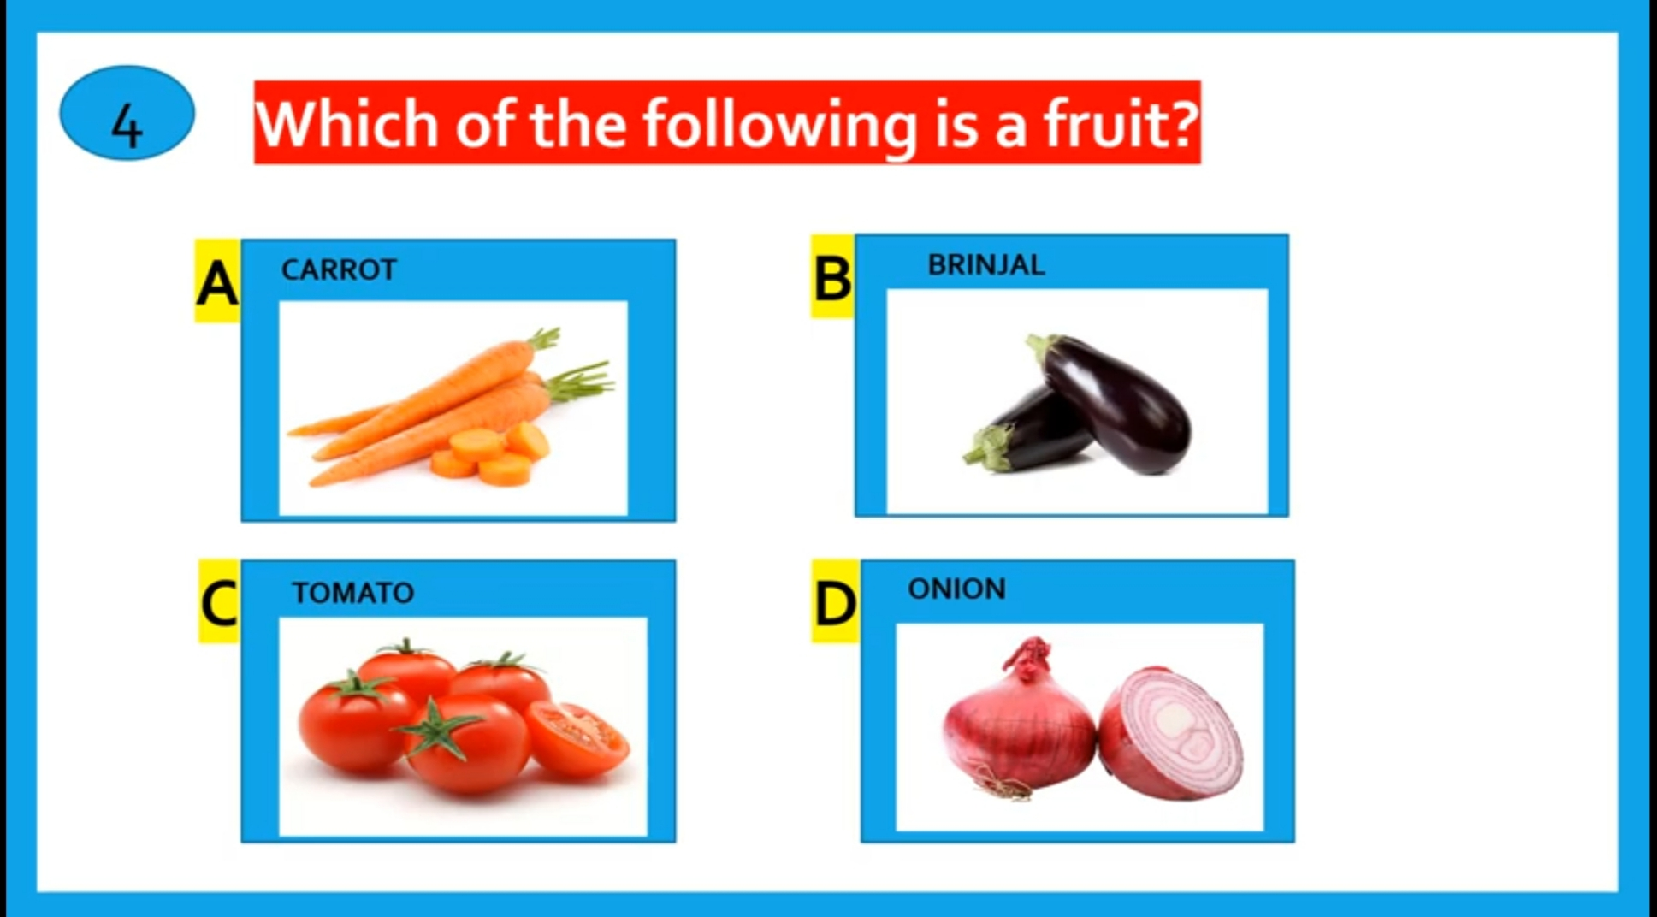
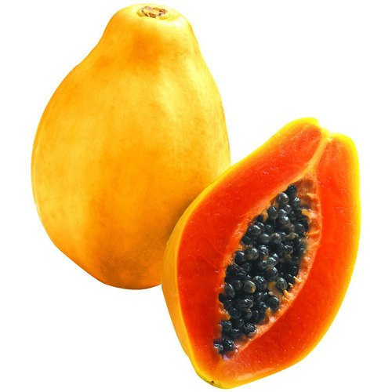

PAPAYA

Slide 3
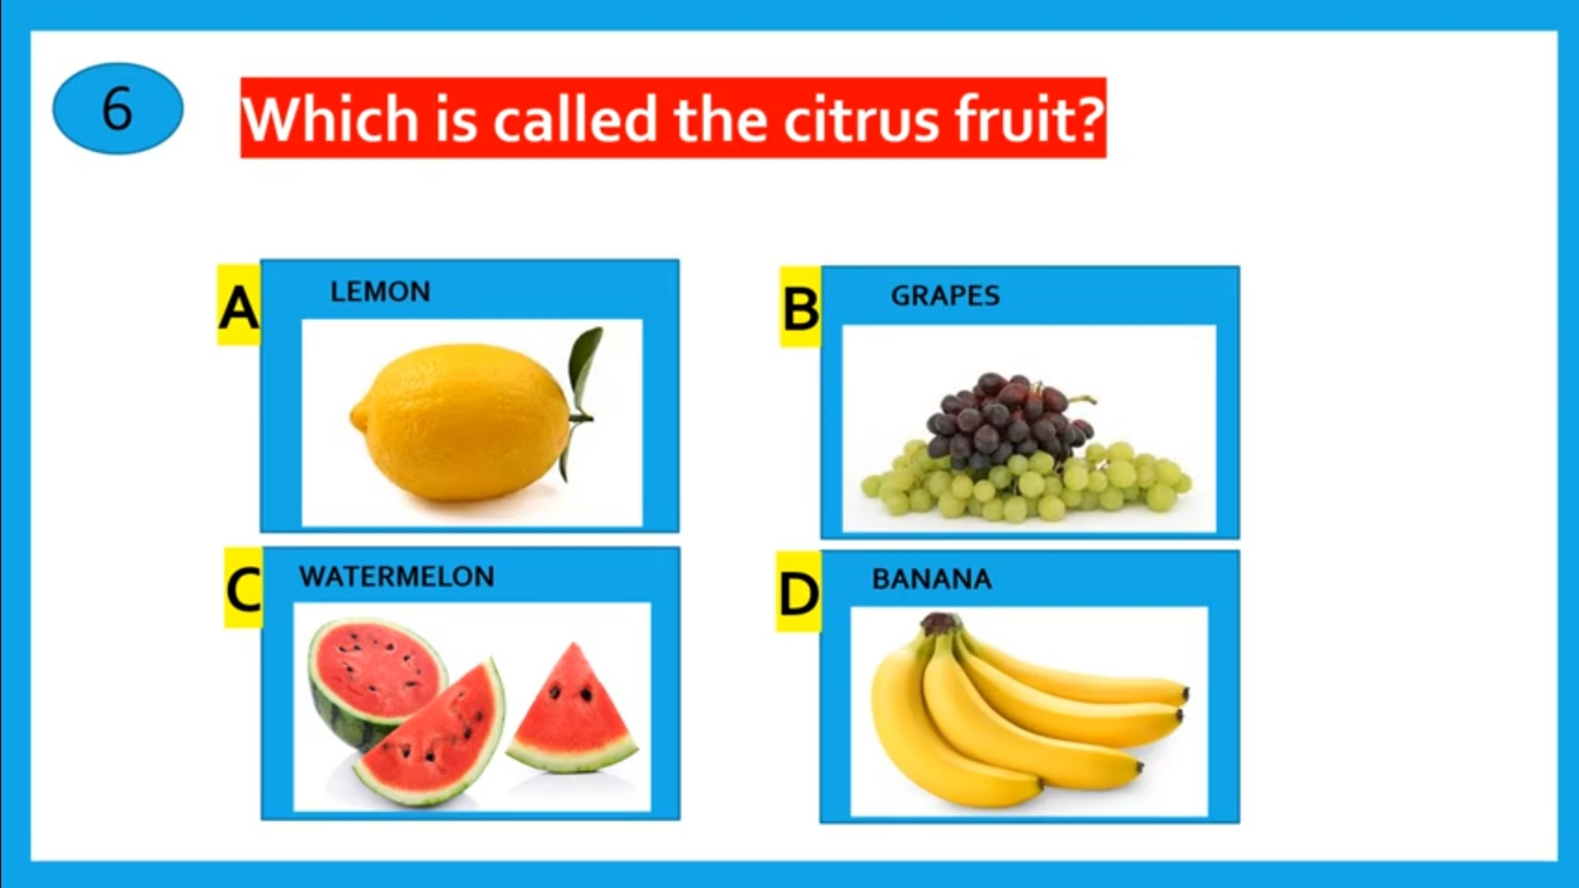
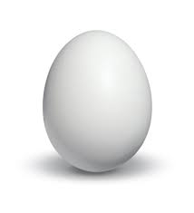
Which food item tastes sour ?
EGG

Slide 4
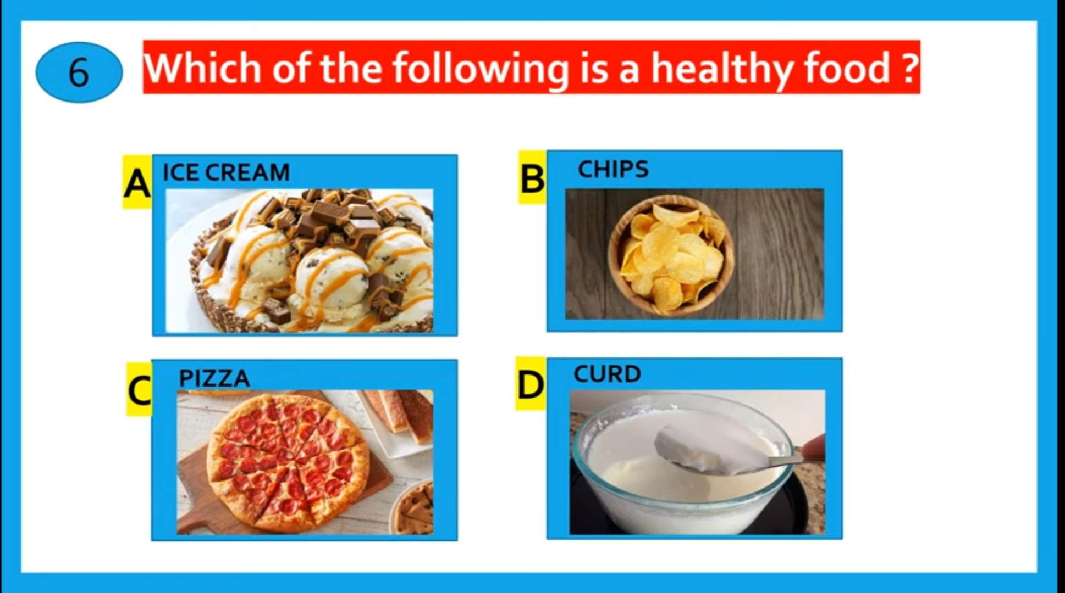
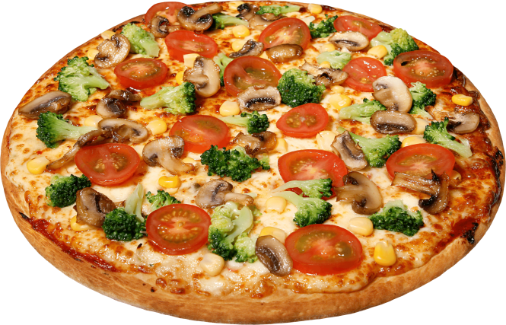

Slide 5
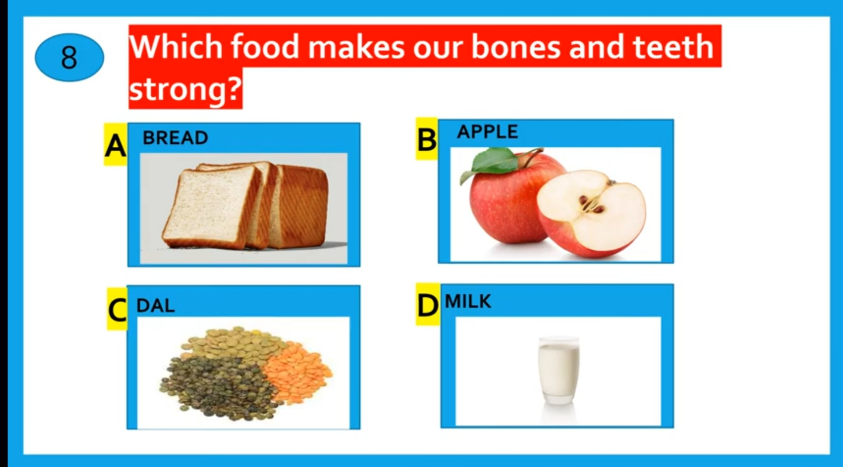
Which food item we get from animals ?

Slide 6
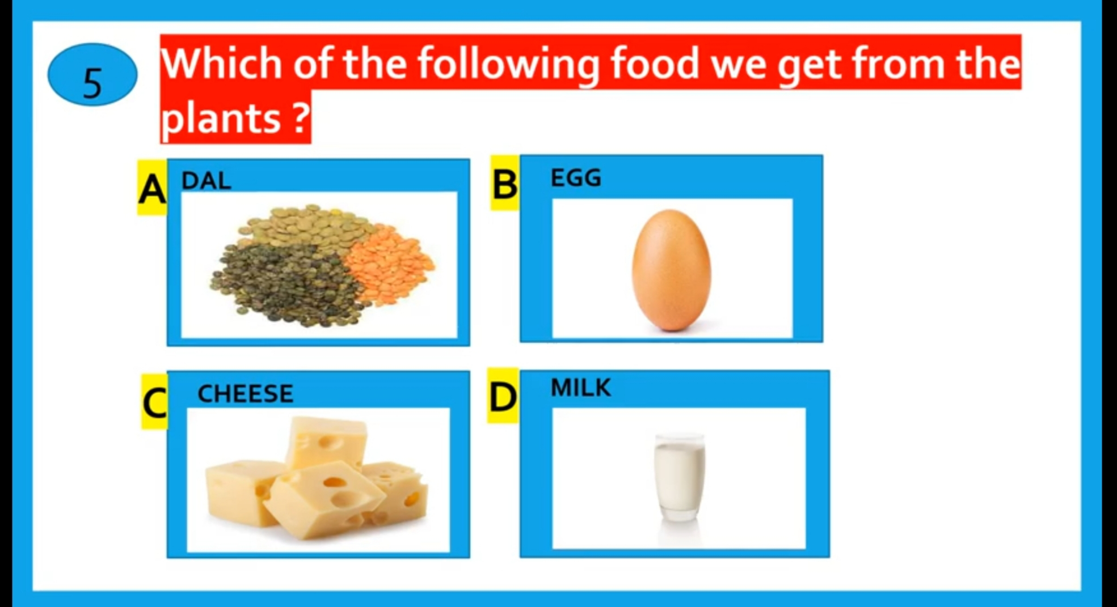

Slide 7
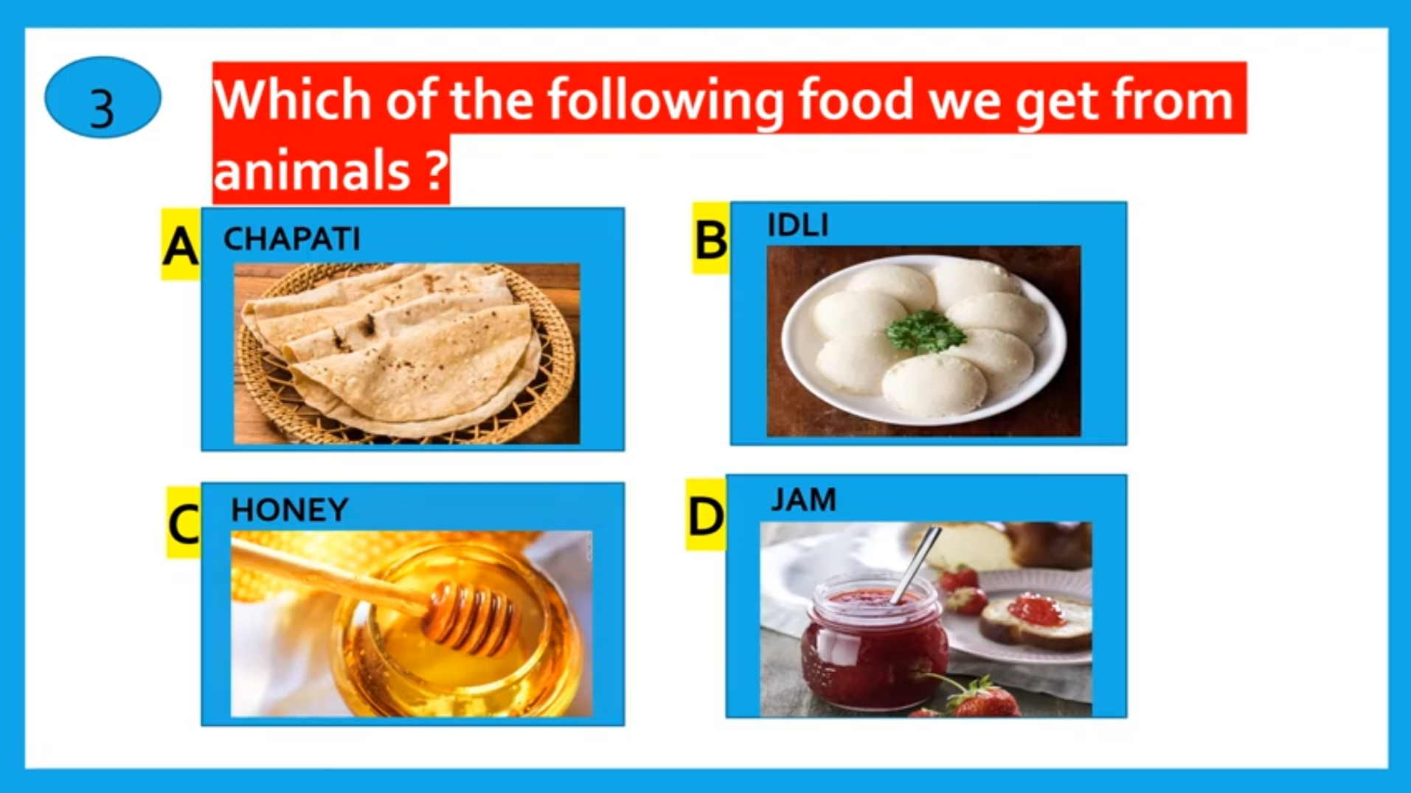
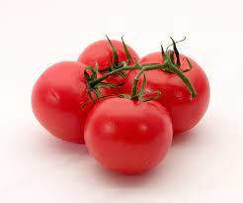
Which food item we prepared from cereals ?
TOMATO

Slide 8
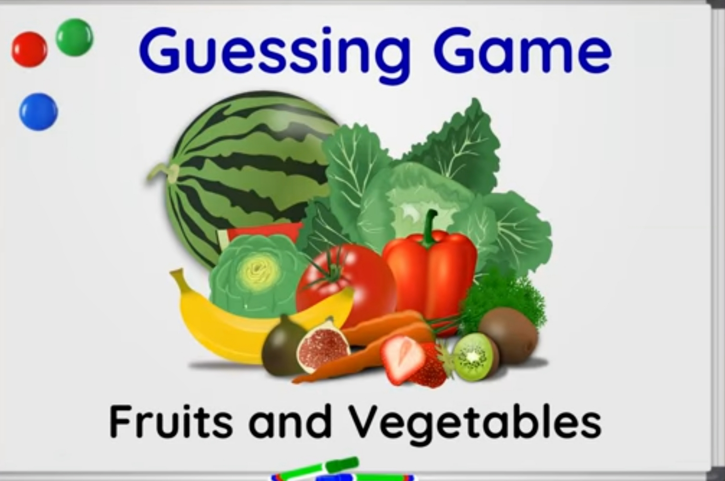

Slide 9
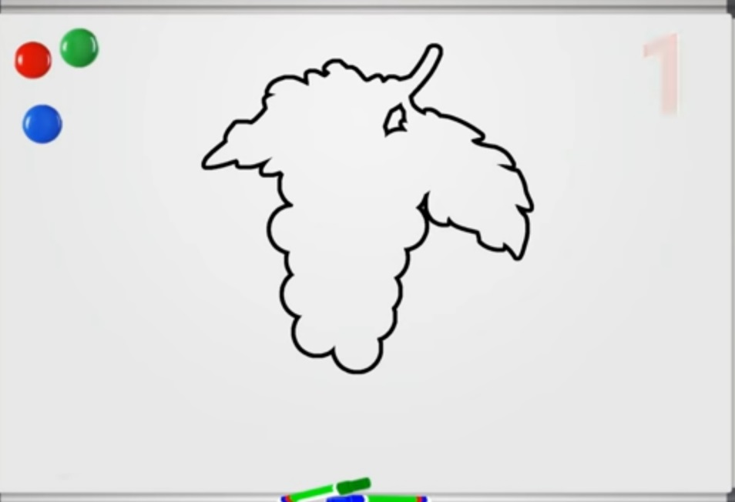
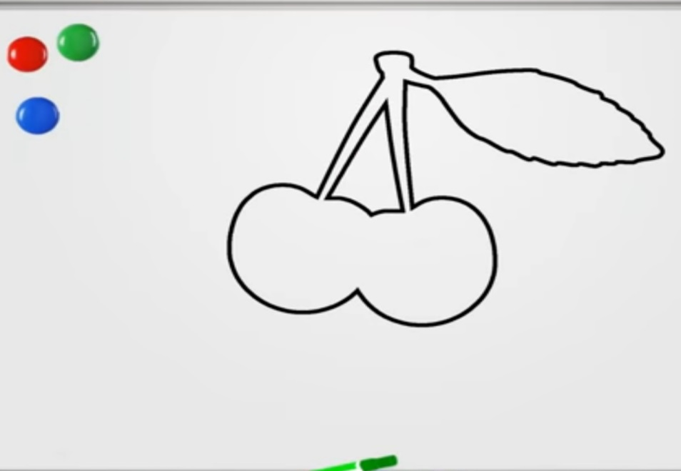
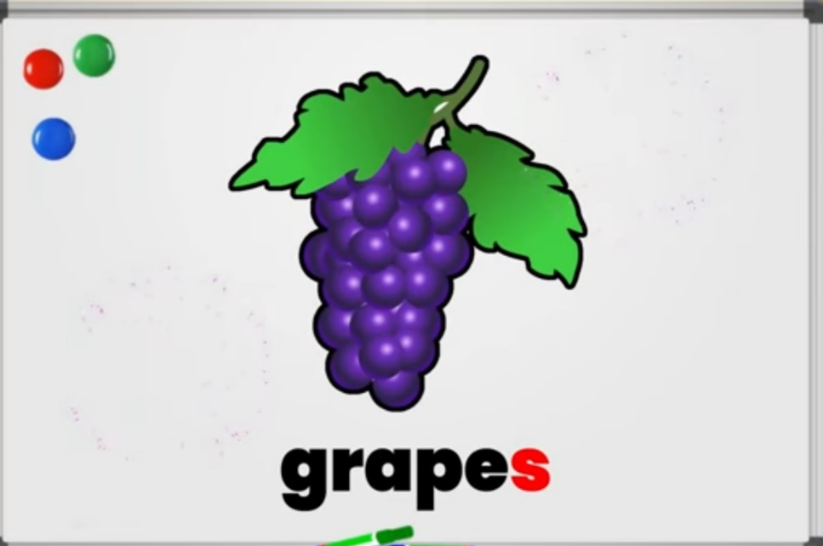

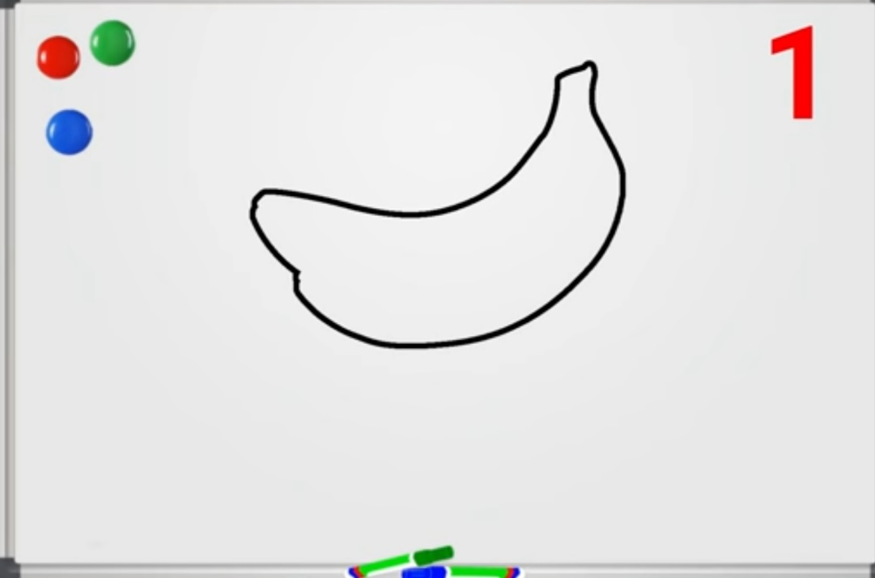
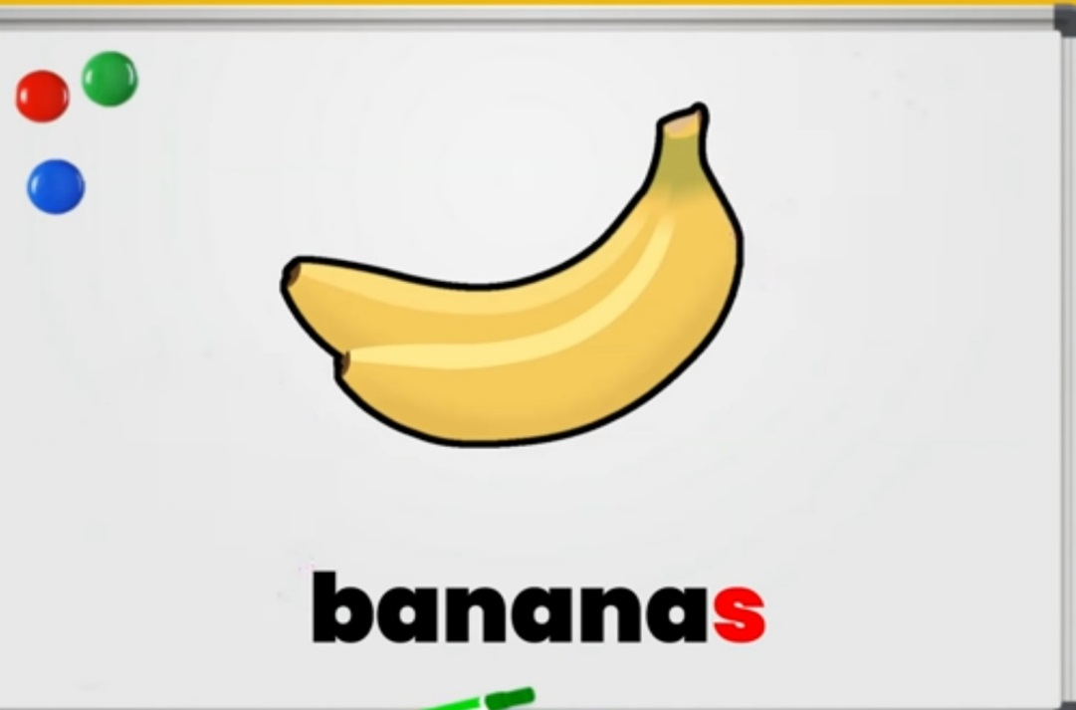
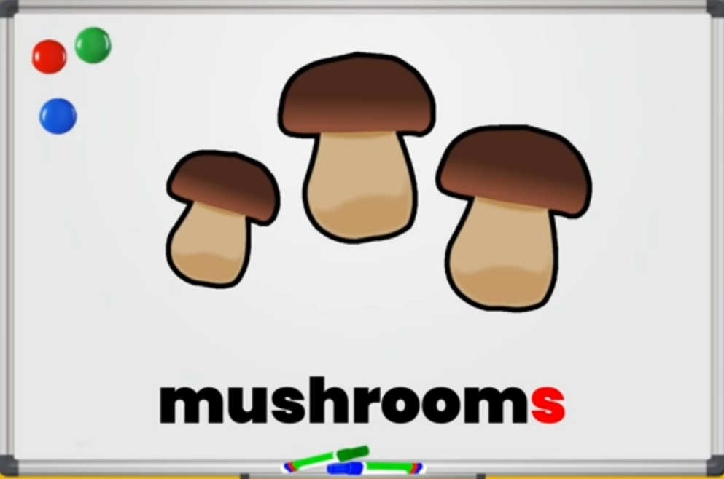
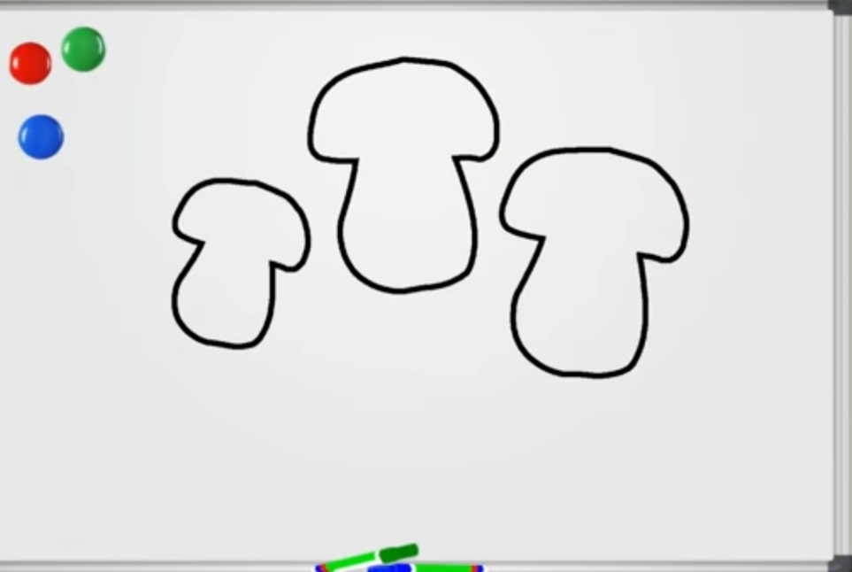

Slide 10
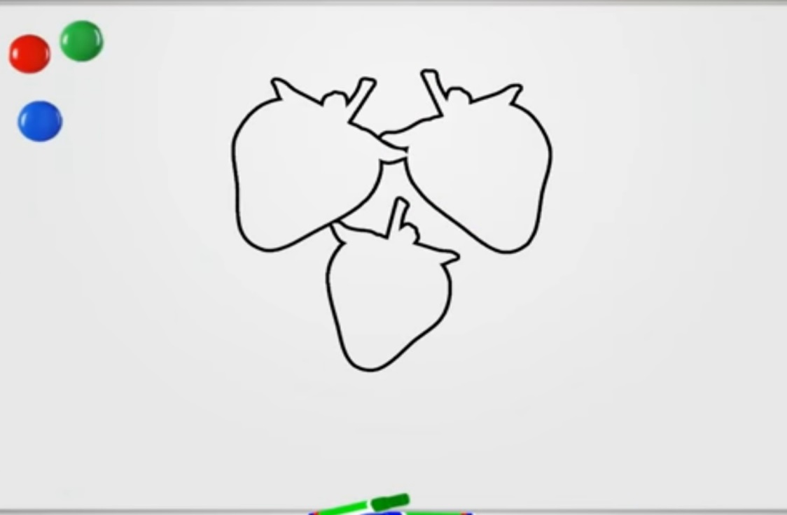
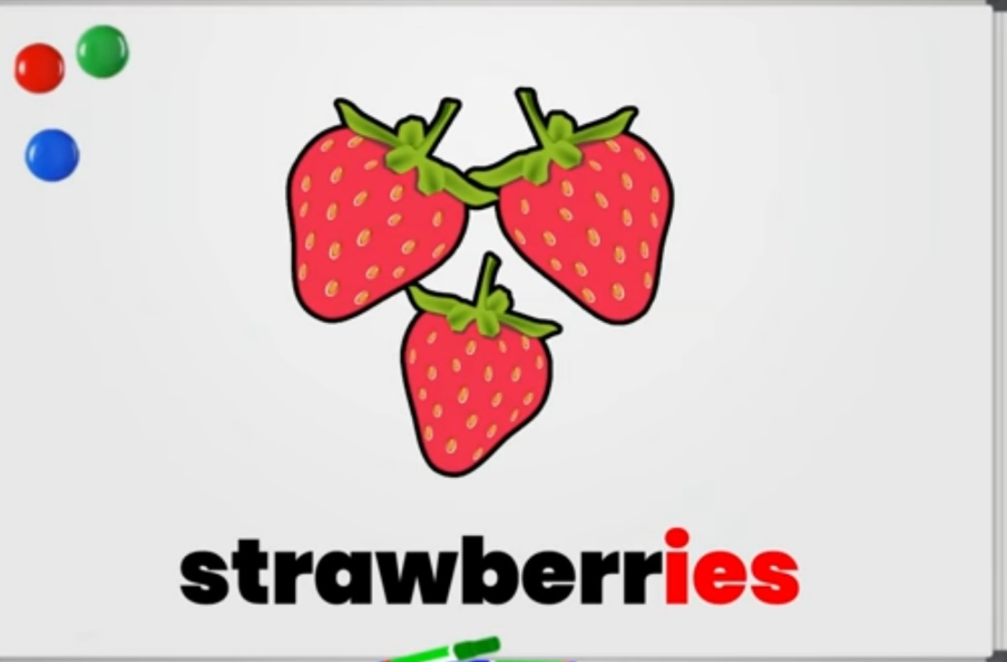
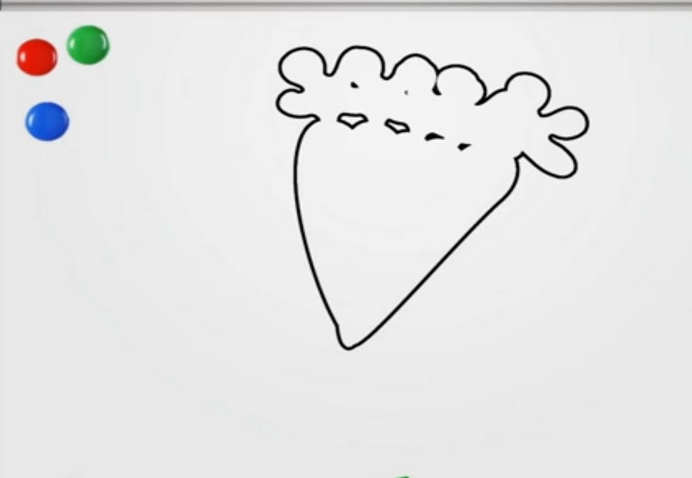
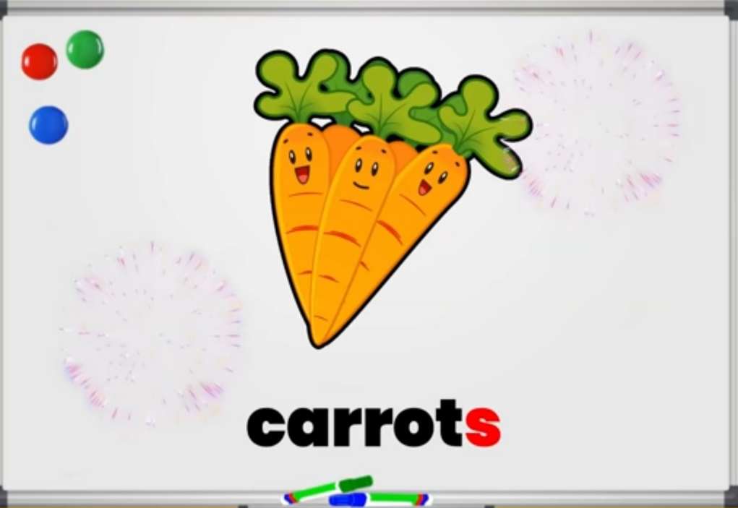
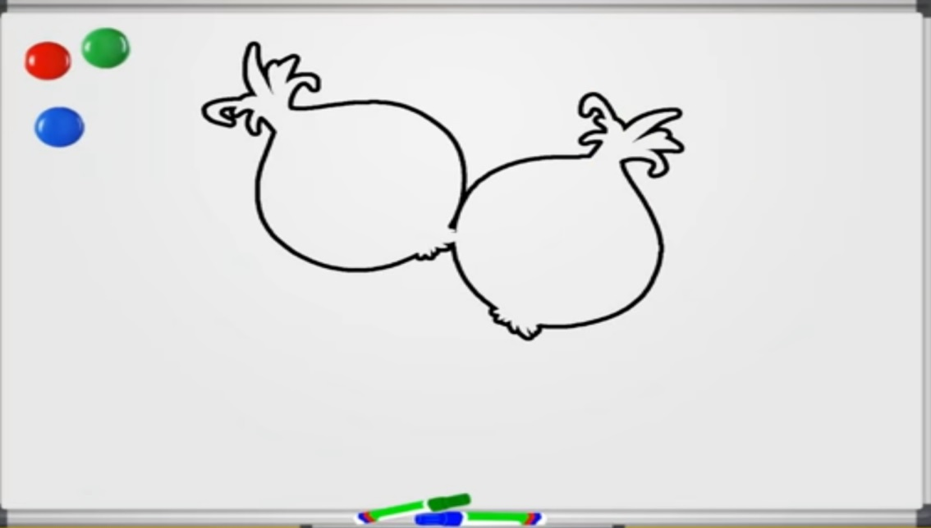
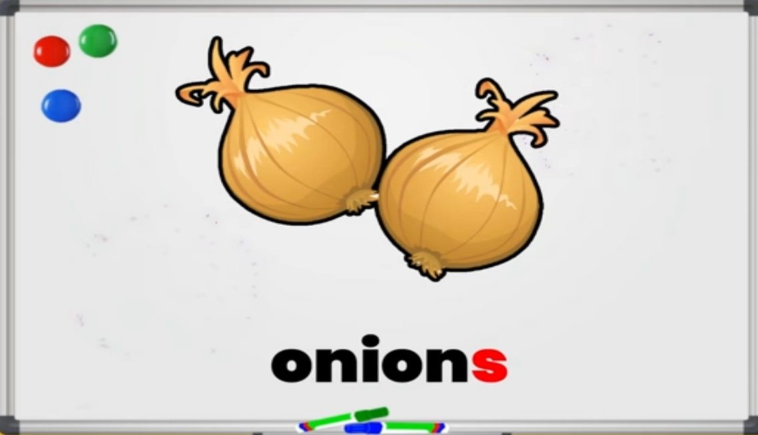

Slide 11

HW
28/7/21
HOME ASSIGNMENT:
Find out the food items from the grid, draw and colour the pictures.
D | F | I | S | H | B | N
G | P | C | T | O | P | L
R | O | R | A | N | G | E
A | T | S | M | E | G | G
P | A | Q | E | Y | H | A
E | T | O | M | A | T | O
S | O | X | M | I | L | K
Ex - FISH

Slide 12

THANKING YOU
ODM EDUCATIONAL GROUP

