Slide 1

WELCOME TO ONLINE CLASS
SUBJECT-ENGLISH
CHAPTER- 6
TOPIC – ACTION WORDS

Slide 2



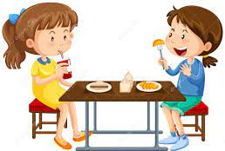
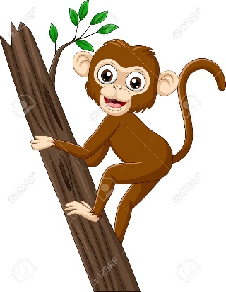
INTRODUCTION : ACTION WORDS
It describes the action done by a person or animal

Slide 3


Identify the actions..
Paint
Sing

Slide 4


Cook
Read

Slide 5

Run
Sleep

Slide 6

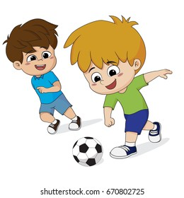

CLASS ASSIGNMENT (ORAL)
Look at the pictures and say things you can do.
I can …………………

Slide 7





HOME ASSIGNMENT(ORAL)
Look at the pictures and say you like doing.
I like to ………….. (any 3)

Slide 8

THANKING YOU
ODM EDUCATIONAL GROUP

