Slide 1

WELCOME TO ONLINE CLASS
CLASS : UKG
SUBJECT : ENGLISH
CHAPTER : 3 ( “oa” sound words )
TOPIC : Passage reading(“oa”sound ) .

Slide 2
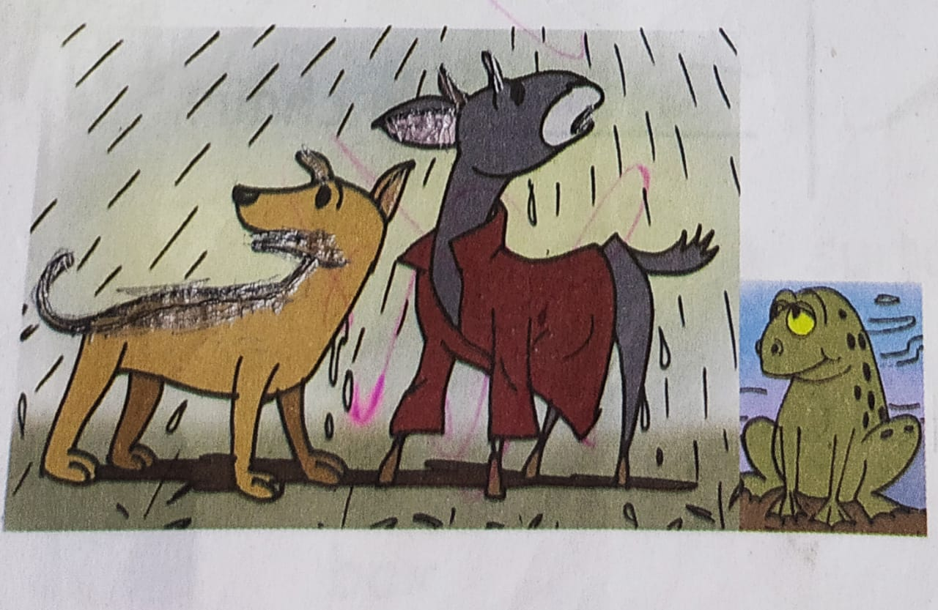

SEEN PASSAGE READING (CLASS ASSIGNMENT)
A dog and a goat are standing on the road .
The goat wears a red coat .
A frog looks at them and says “croak! croak!”

Slide 3
LIST OF “OA”SOUND WORDS FROM THE PASSAGE
goat
coat
road
croak

Slide 4
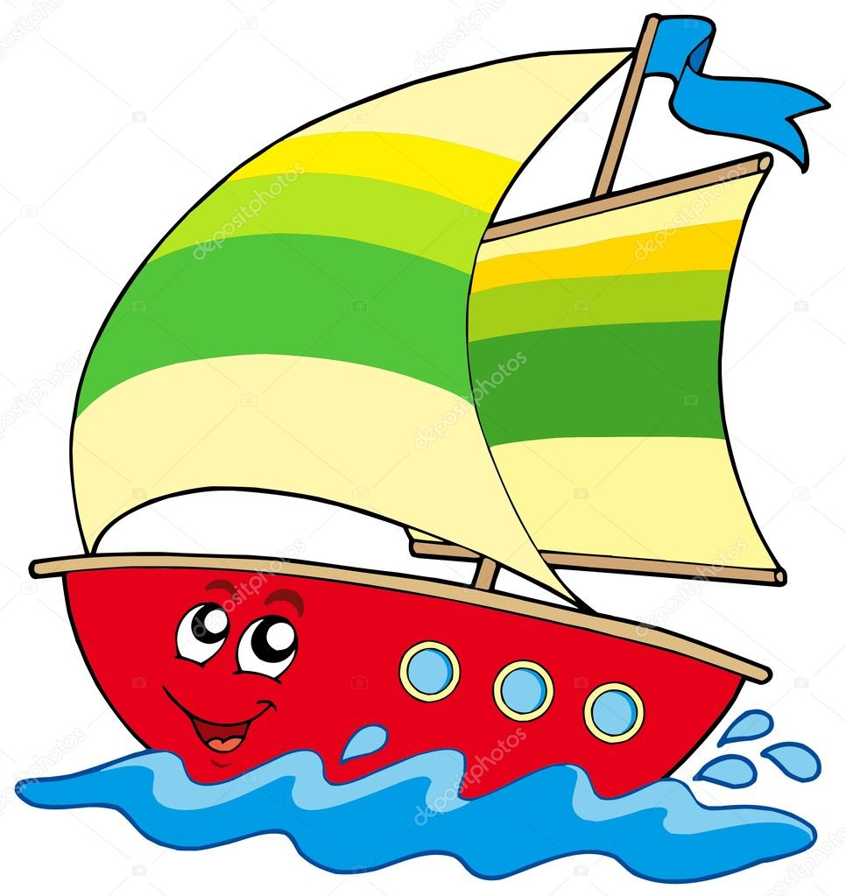

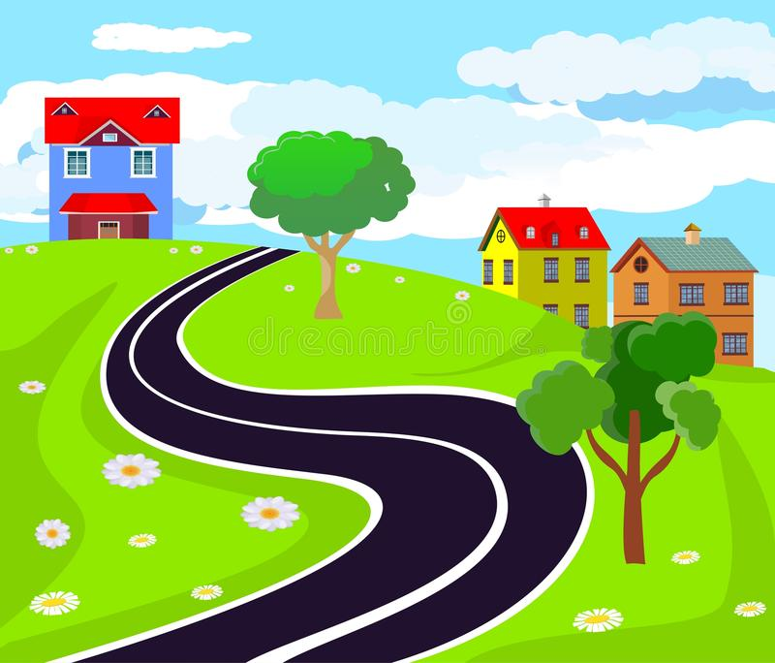
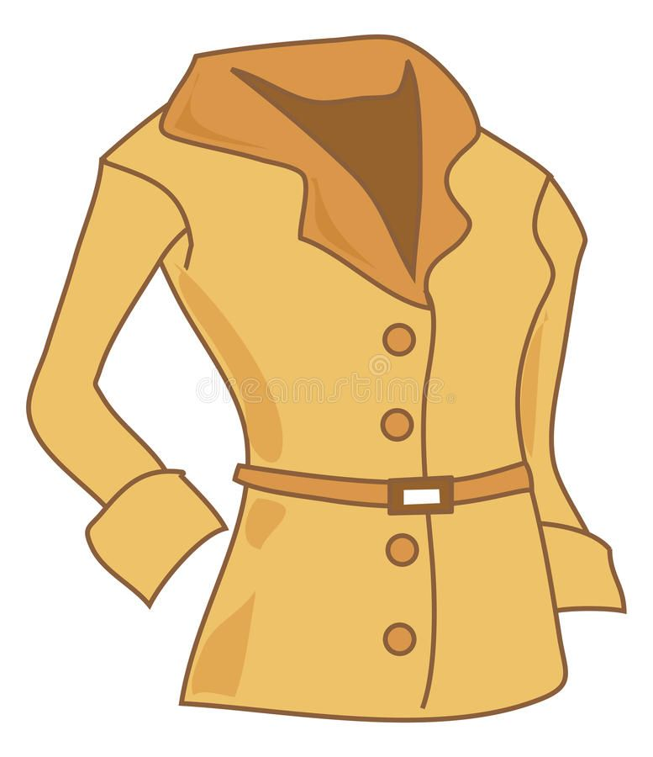
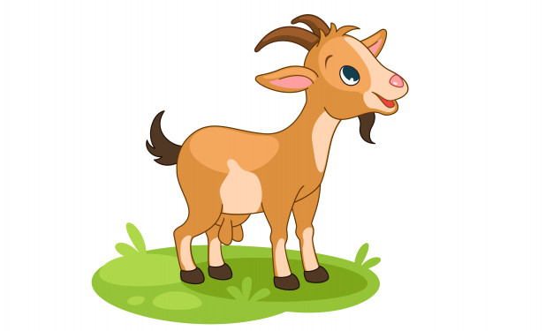
FILL IN THE BLANKS WITH CORRECT WORD
Home Assignment
The can float.
2. I like to eat .
This is very long.
4. This is my .
5. There is a in the garden.

Slide 5
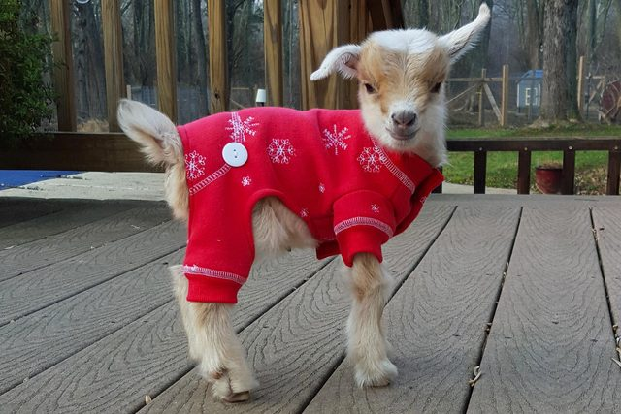
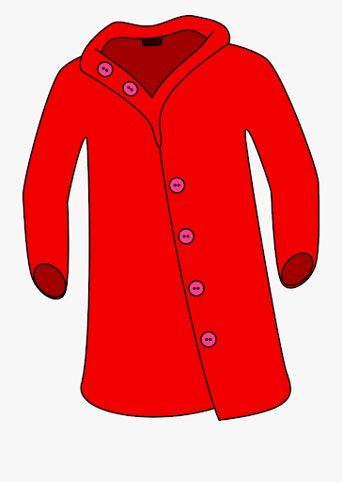
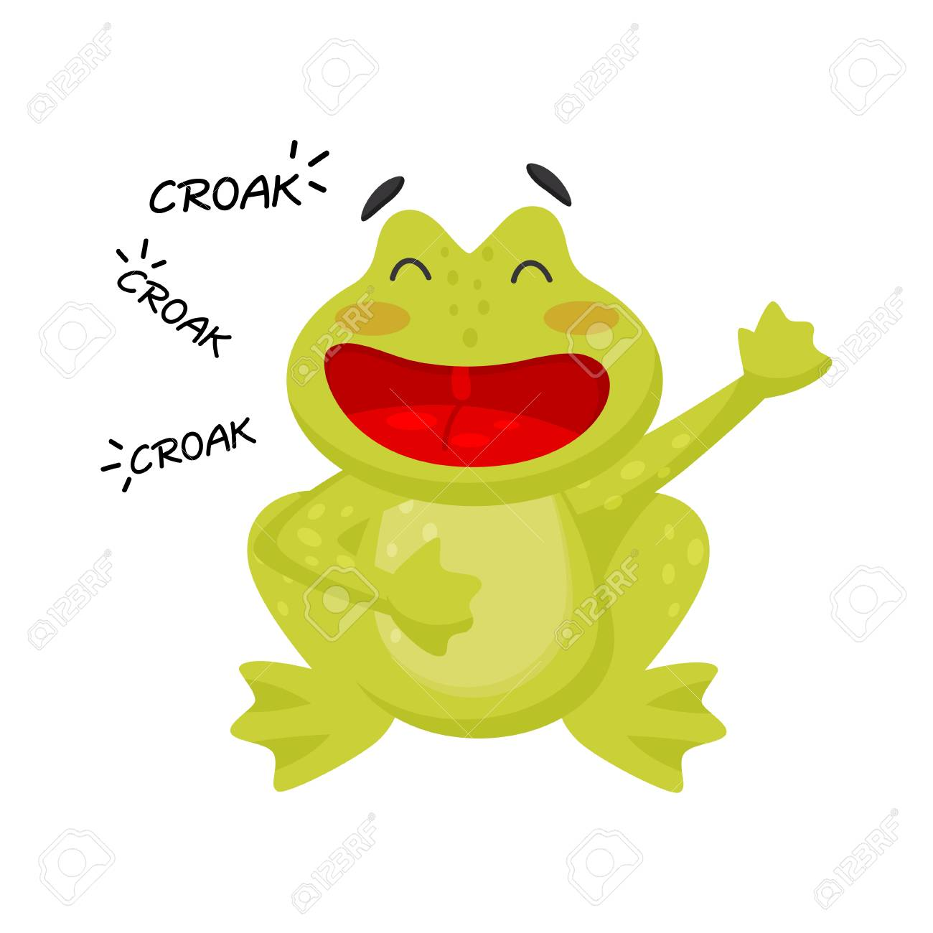
6.The wears a red
7. The frog says
8. The dog and goat are standing on the

Slide 6

THANKING YOU
ODM EDUCATIONAL GROUP

