Slide 1

WELCOME TO ONLINE CLASS
CLASS : UKG
SUBJECT : ENGLISH
CHAPTER : 3 ( “oa” sound words )
TOPIC : Let’s learn the spellings (“oa”sound ) .

Slide 2

LET’S READ THESE WORDS ONCE AGAIN
Boat
Croak
Coat
Road
Goat
Foam
Soap
Oak
Toast
Oats

Slide 3
Write the following words in your classwork copy
(CLASS ASSIGNMENT)
(Vocabulary)
oa
loaf
toast
float
toad
throat

Slide 4
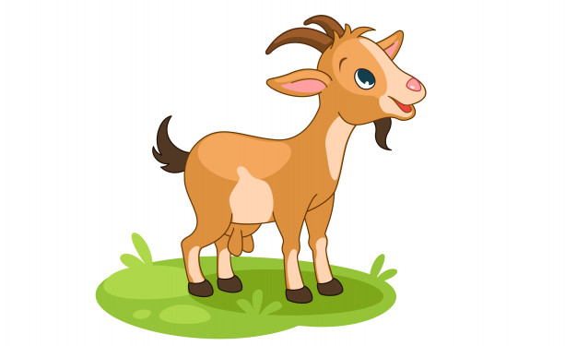

CIRCLE THE CORRECT SPELLING (HOME ASSIGNMENT)
goat , gaot , gote
toste , tost , toast

Slide 5

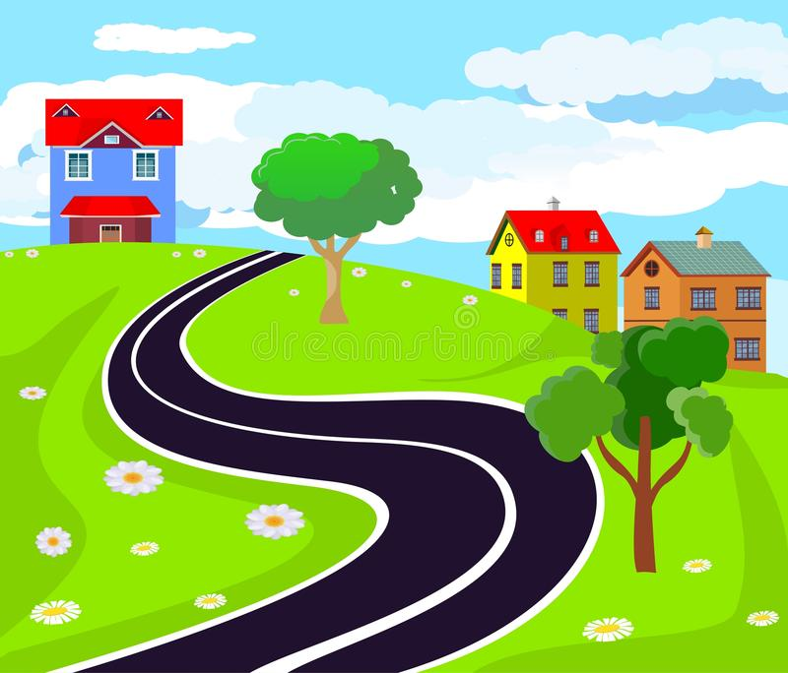
Coat , Caot , Cot
Rod, Road, Rode

Slide 6

THANKING YOU
ODM EDUCATIONAL GROUP

