Slide 1


WELCOME TO ONLINE CLASS
CLASS : UKG
SUBJECT : ENGLISH
CHAPTER : 9
TOPIC : Use of ‘a’ and ‘an’

Slide 2






Class Assignment: Worksheet- 1 . Write in your copy
Dt. 4.1.22
Name the picture using a or an.

Slide 3
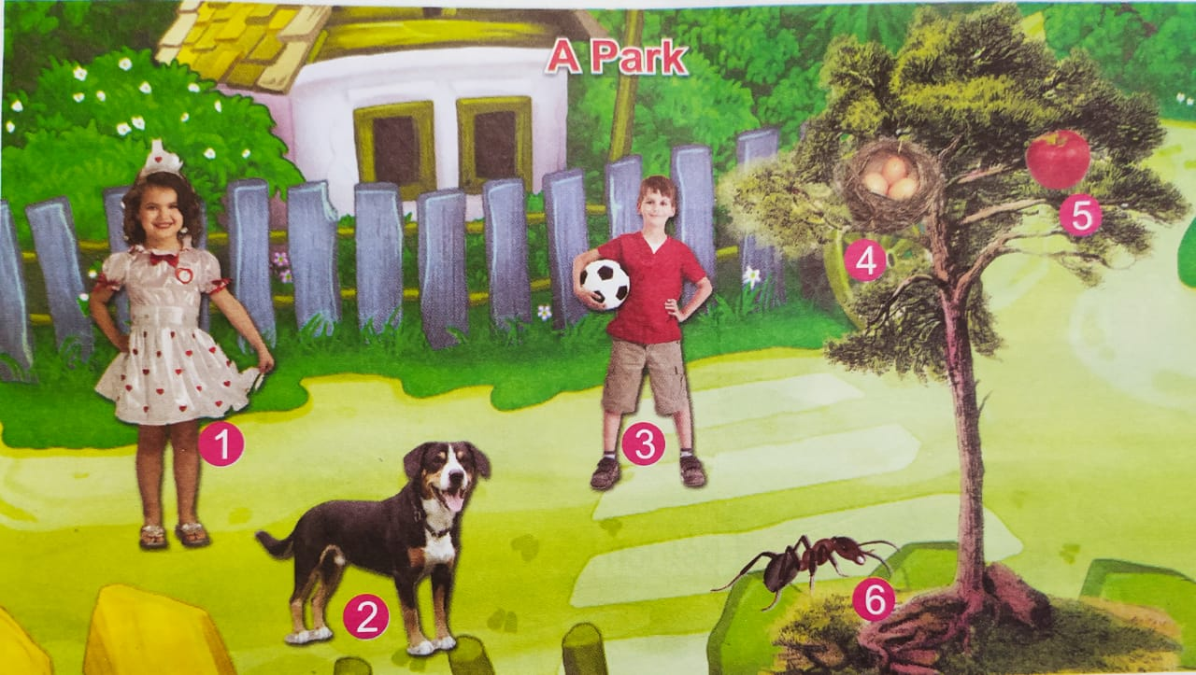
Worksheet – 2 write in your copy
Picture composition using a/an. One has been done for you.
I see a girl.
I see ………………….
I see ………………….
I see ………………….
I see ………………….
6. I see ………………….

Slide 4

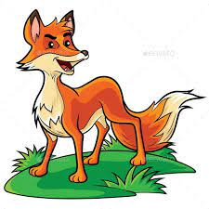



Home Assignment :
Write in full sentence what is it ? One has been done for you.
It is a fox.

Slide 5
THANKING YOU
ODM EDUCATIONAL GROUP

