Slide 1


CLASS : UKG
SUBJECT : ENGLISH
CHAPTER : 9
TOPIC : Uses of “a” and “an”

Slide 2
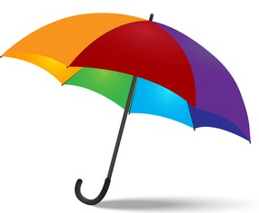

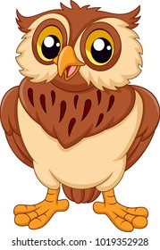
DT. 3/1/22
Introduction: Use of “a” and “an”
‘a’ or ‘an’ is used for one person, one animal, one object or one place etc.
‘An’ is used for words beginning with letter – A, E, I, O, U
An umbrella
An apple
An owl

Slide 3
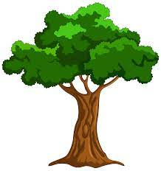

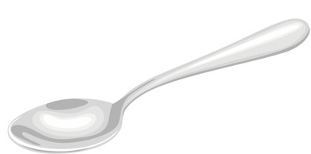
‘A’ is used for words beginning with letters other than A,E,I,O,U
A balloon
A tree
A spoon

Slide 4

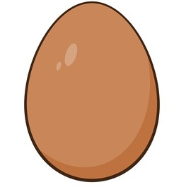

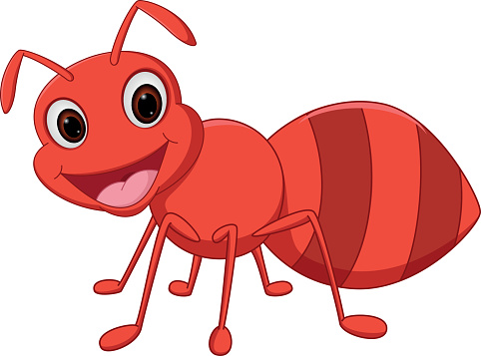
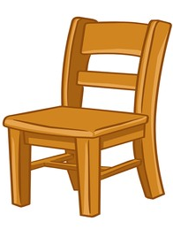
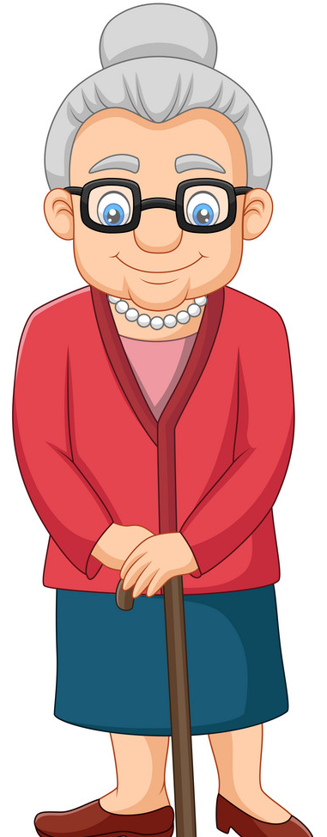
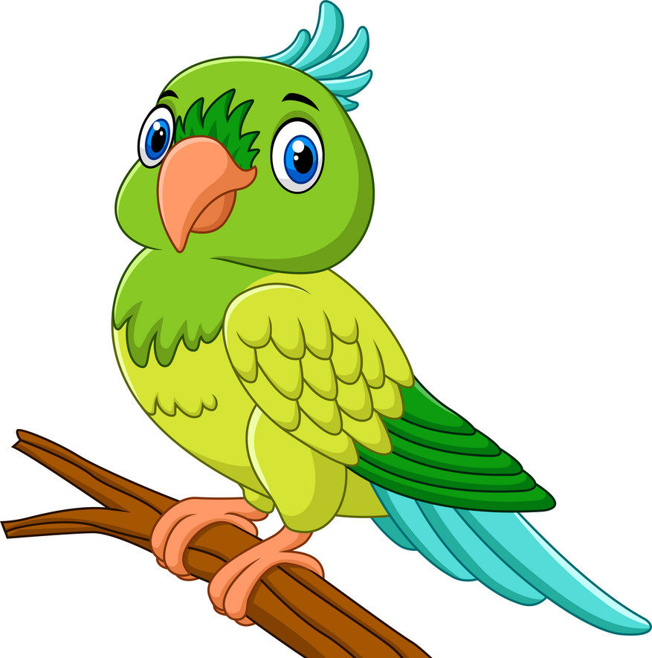

Class assignment: Write a or an in the blank before each word. (Book Pg- 51)
……… fish
…….. ant
3. ……… chair
4. …... parrot
5. ……. man
6. …… egg
7. ….. orange
8. ……. old woman

Slide 5



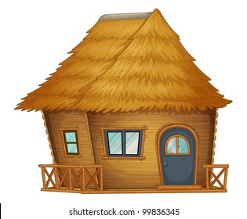
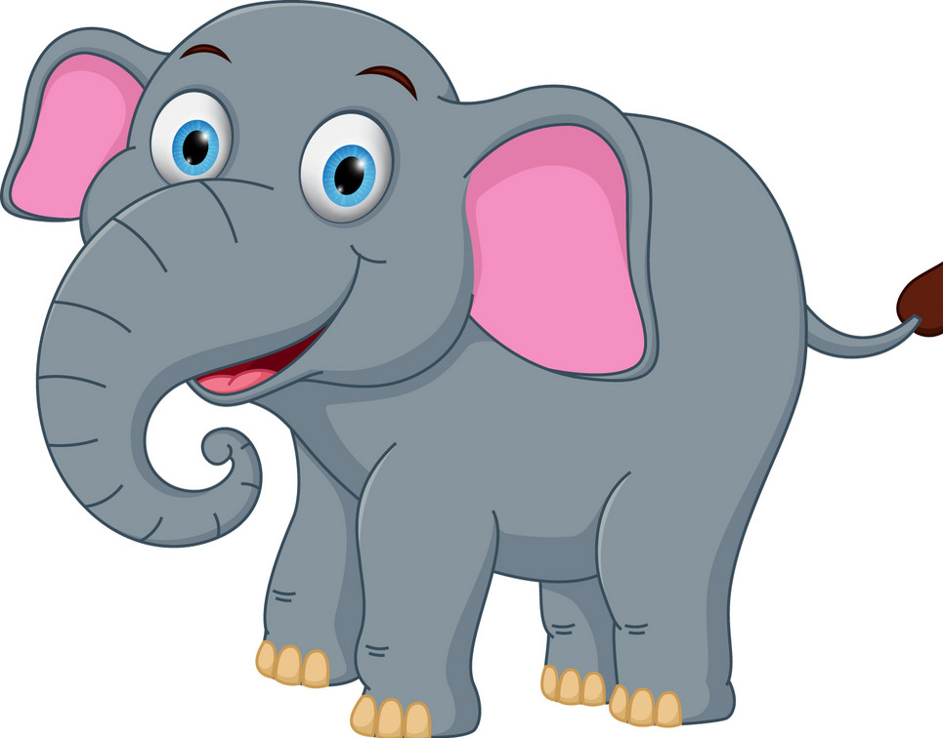
Home assignment: Name the pictures using ‘a’ or ‘an’

Slide 6
THANKING YOU
ODM EDUCATIONAL GROUP

