Slide 1


WELCOME TO ONLINE CLASS
CLASS : UKG
SUBJECT : ENGLISH
CHAPTER : 8
TOPIC : Revision

Slide 2
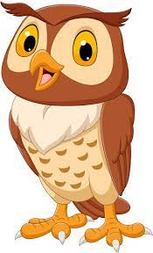
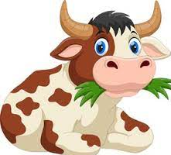
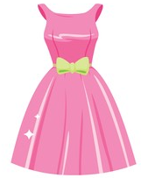

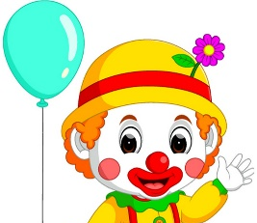

Class Assignment: Write in your copy
Dt.25.1.22
Read the passage and write – ow sound words from it.
An and a go to see the queen.
She wears a . She wears a .
There is a with the queen. He makes
everyone laugh. The and laugh and
laugh and fall .

Slide 3
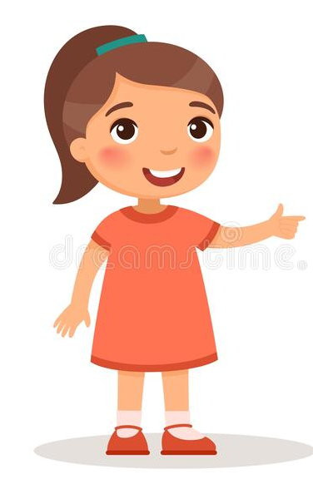
Write the rhyming words for the following.
Town …………….
2. Owl …………….
3 . Cow ............
4. Brown ………….
5. Gown ……………

Slide 4
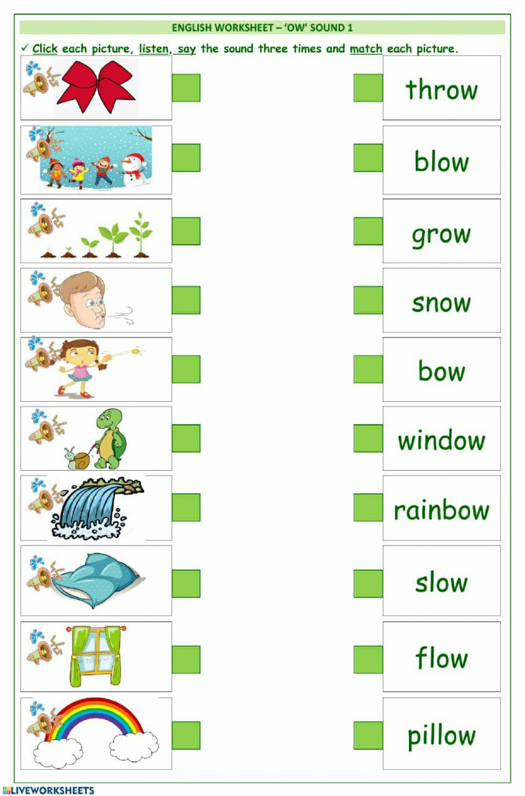
Home Assignment : Match the following

Slide 5
THANKING YOU
ODM EDUCATIONAL GROUP

