Slide 1


CLASS : UKG
SUBJECT : ENGLISH
CHAPTER : 10
TOPIC : CLOTHES WE WEAR (notebook work)

Slide 2
DT. 19.1.22
C.W.
CLOTHES WE WEAR
Write 4 names each what we wear.
BOYS
GIRLS

Slide 3

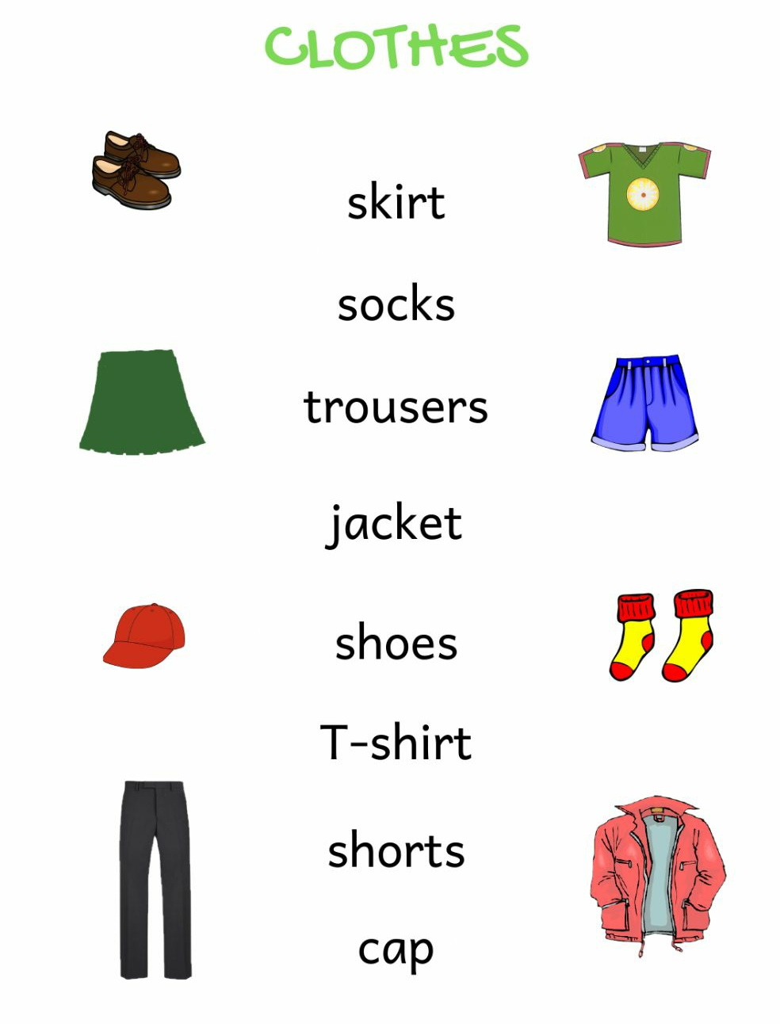
ACTIVITY - 2
Match the following

Slide 4
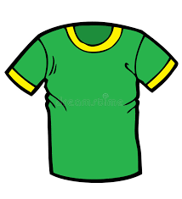

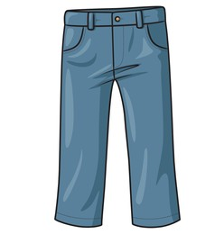
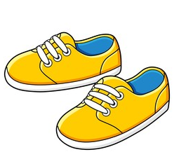
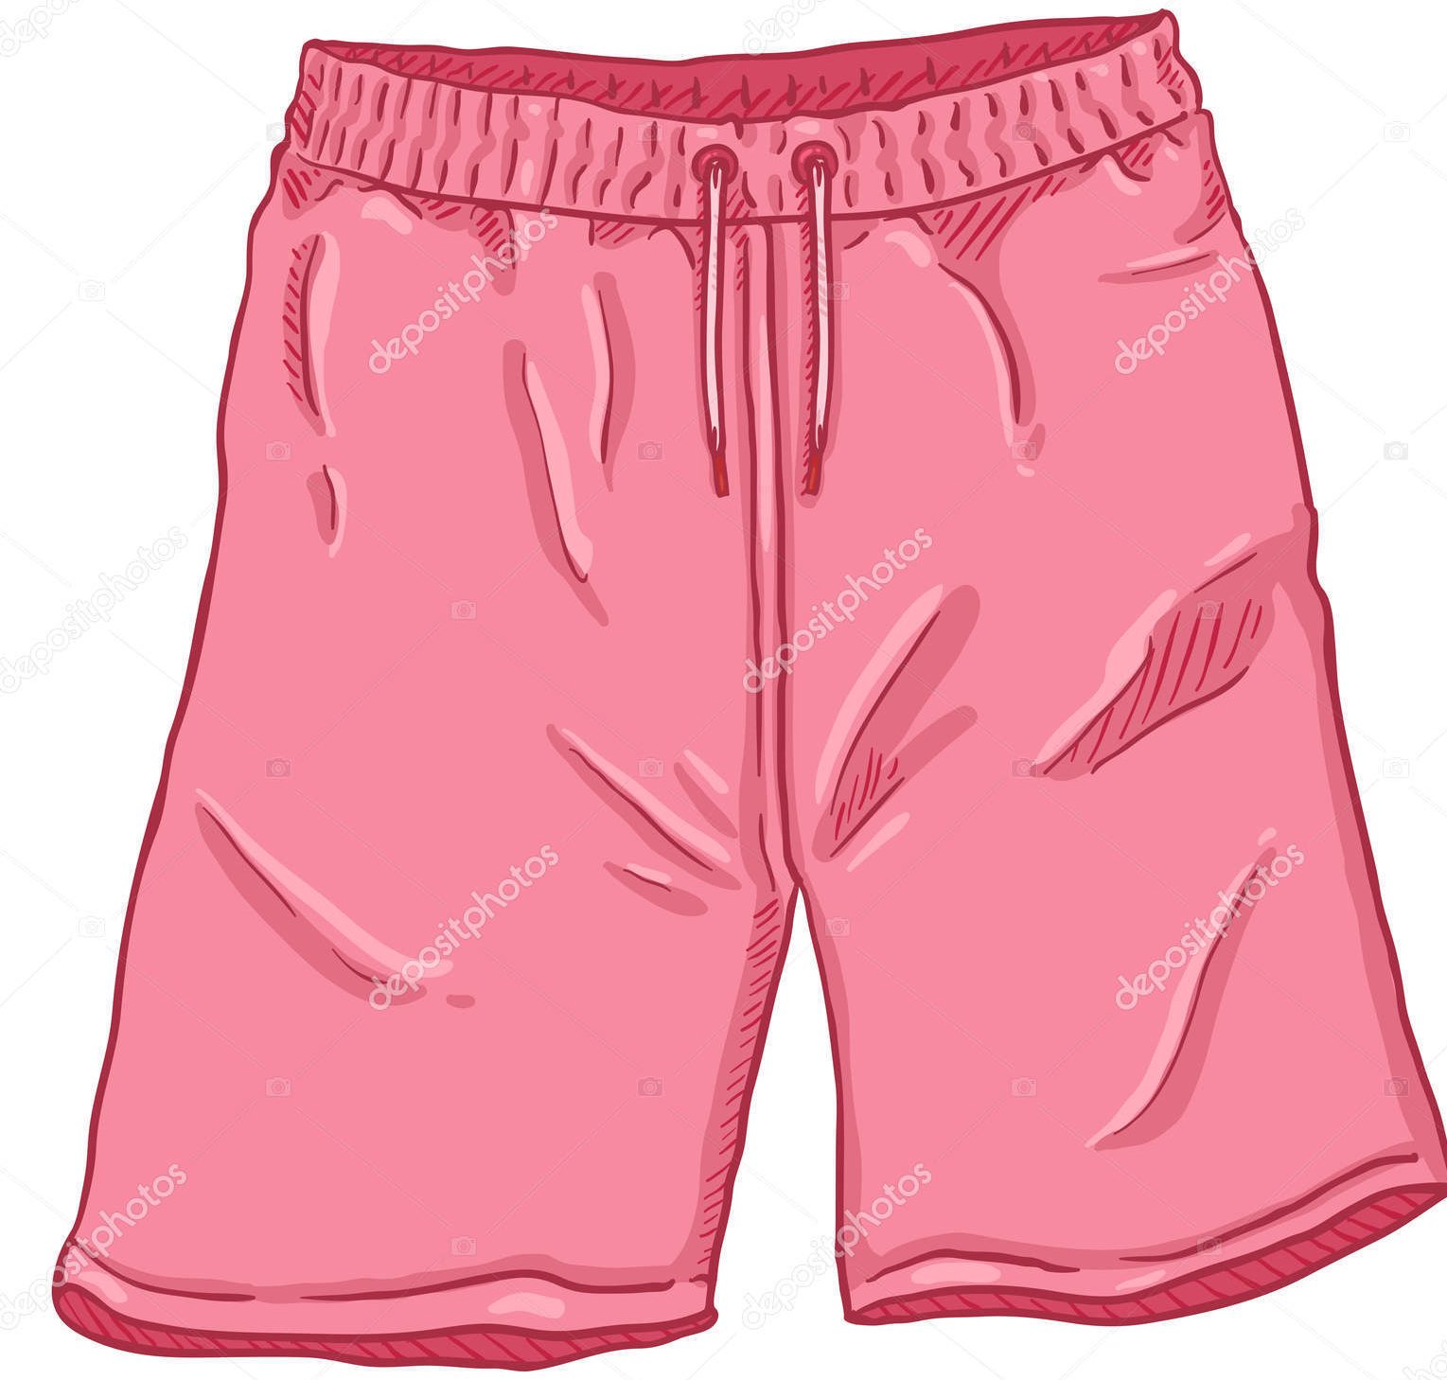
ACTIVITY - 3
Look and complete the sentences.
A green ………..
A red …………..
A blue …………..
Yellow…………
A pink …………..

Slide 5

HOME ASSIGNMENT
Learn book page no. 56
Passage .

Slide 6
THANKING YOU
ODM EDUCATIONAL GROUP

