Slide 1

WELCOME TO ONLINE CLASS
SUBJECT-ENGLISH
CHAPTER- 6
TOPIC – PASSAGE READING (‘ch’ sound words)

Slide 2
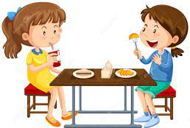



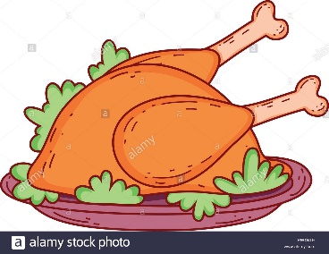


CLASS ASSIGNMENT : PASSAGE READING
Chinky is a girl. She likes to eat chips, cheese, chocolate, chicken, cherries . One day I was at lunch when I saw my friend, Chinky. She sat next to me on the bench . We had our lunch . It was fun !

Slide 3

Write in your notebook .
Complete the sentences using ‘ch’ sound words
1. I like to eat ……………..
2. I like to eat ……………..
3. I like to eat ………………..
4. I like to eat …………………..
5. I like to eat …………………..

Slide 4
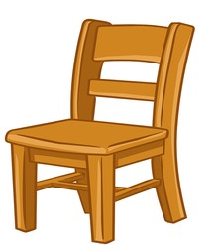
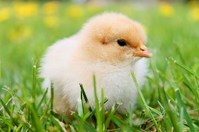


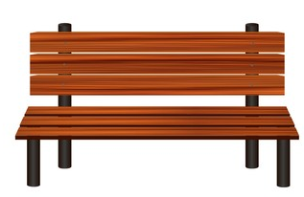
BOOK PAGE : 30 – DO IN THE TEXTBOOK
Circle the correct word :
chair , chase share
chip , chin , chick
chat , chin , cheek
catch , shake , watch
bunch , lunch , bench

Slide 5
Home Assignment : Learn the spellings
Chips
Chicken
3. Chocolate
4. Cherry
5. Cheese

Slide 6

THANKING YOU
ODM EDUCATIONAL GROUP

