Slide 1

WELCOME TO ONLINE CLASS
SUBJECT-ENGLISH
CHAPTER- 4
TOPIC - Uses of 'These' and 'This'

Slide 2
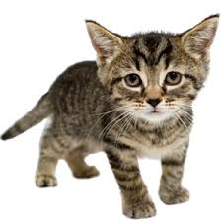
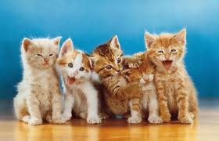
LET US REVISE AGAIN
ONE : This is a cat.
Many : These are cats .

Slide 3
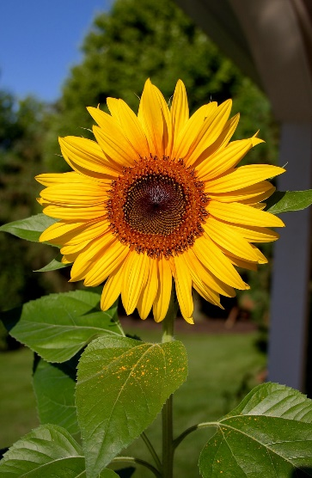
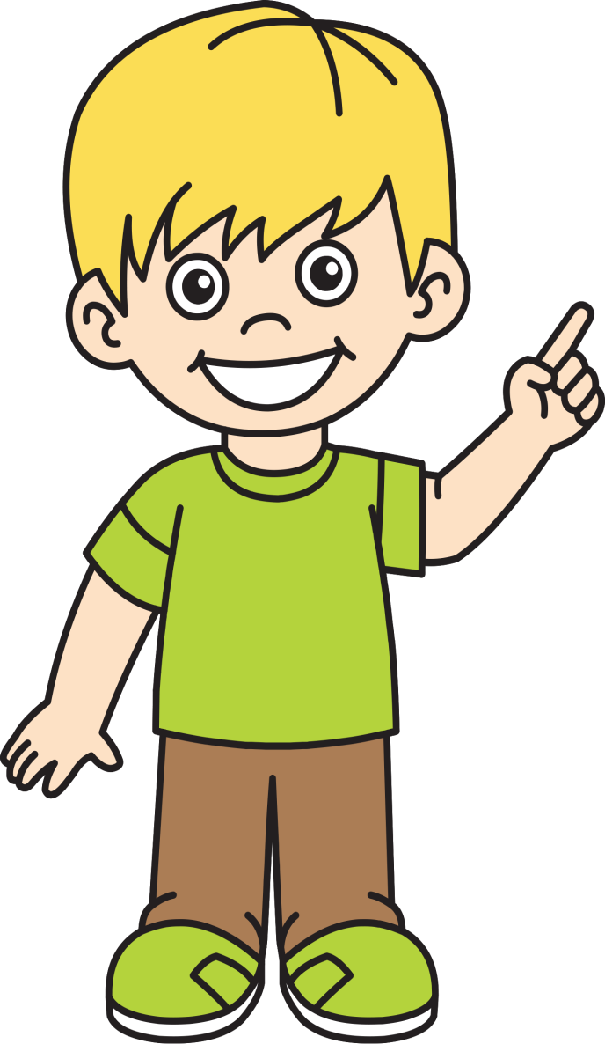
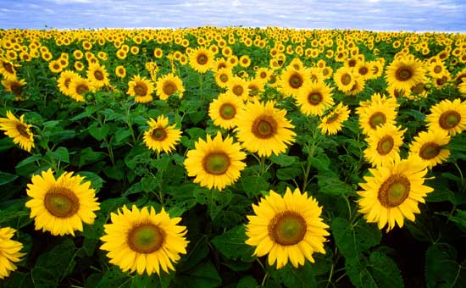
This is a flower.
These are flowers.

Slide 4
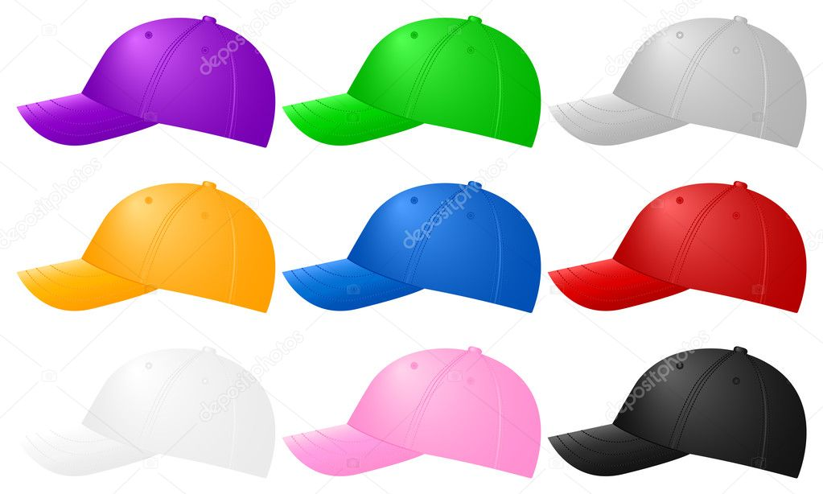
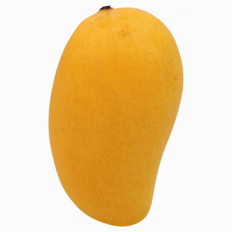
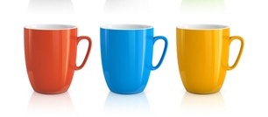
Fill in the blanks using This or These
Class Assignment
1.
……………… is a cat.
2.
…………… are cats .
3.
…………….. are caps .
4.
………….. is a mango.
5.
…………….. are cups.

Slide 5
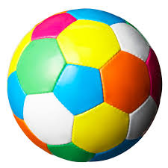
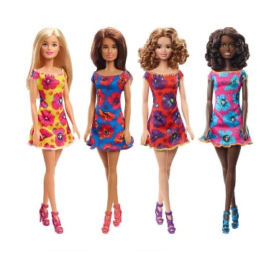
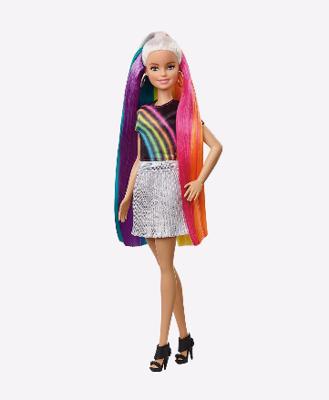
Match the following ( Home Assignment)
Do in your notebook
These are balls .
This is a ball .
This is a doll.
These are dolls.

Slide 6

THANKING YOU
ODM EDUCATIONAL GROUP

