Slide 1


CLASS : UKG
SUBJECT : ENGLISH
CHAPTER : 8
TOPIC : USSAGE OF ‘is’ and ‘are’ ( REVISION)

Slide 2


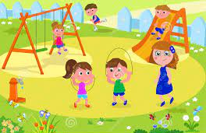

USAGE OF ‘IS’ AND ‘ARE’
27-01-22
Fill the blanks using ‘is’ or ‘are’
There_______ a spoon on the plate.
Birds _______flying in the sky.
Children ______ playing in the park.
This _______a lotus.

Slide 3
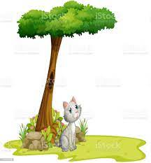
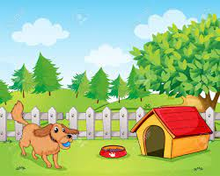


USSAGE OF ‘IS’ AND ‘ARE’
e)There_______ a cat under the tree.
f)There _______a big dog in my yard.
g)The girl _______sleeping on the bed.
h) There _______cookies in the jar.

Slide 4
HOME ASSIGNMENT
Fill in the blanks using ‘is’ or ‘are’
There __________ a pencil on the table.
There _________three erasers in the box.
The monkeys _________on the tree.
The elephants ________in the zoo.
How many girls ________ there in the class?
The teacher ________ in the classroom.

Slide 5
THANKING YOU
ODM EDUCATIONAL GROUP

