Slide 1

WELCOME TO ONLINE CLASS
SUBJECT-ENGLISH
CHAPTER- 6
TOPIC – SEEN PASSAGE (‘ch’ sound words)

Slide 2
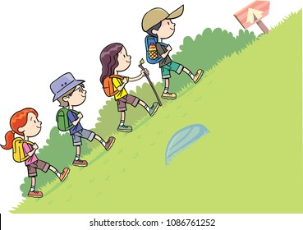

CLASS ASSIGNMENT : PASSAGE READING
The children go up the hill .
It is chilly on the hill .
They go to a church on the hill.
They eat chapatis and chips on the hill .

Slide 3
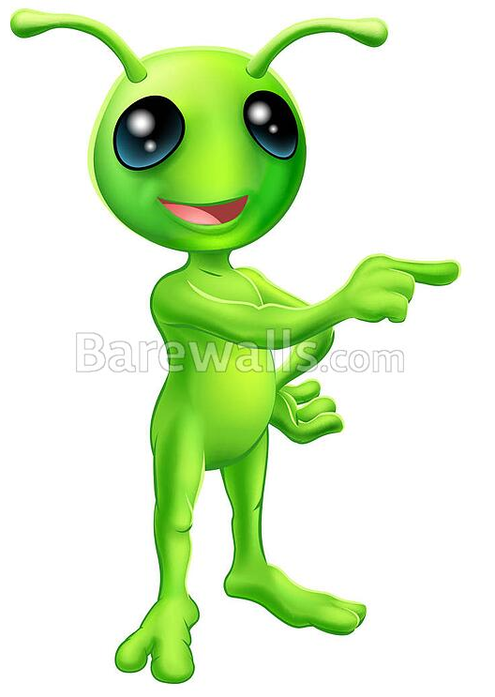
Write the passage in your copy and circle the “ch” sound words .
Children
chapatis
chilly
chips
church

Slide 4
HOME ASSIGNMENT
READ THE PASSAGE TWICE ( BOOK PAGE – 29 )

Slide 5

THANKING YOU
ODM EDUCATIONAL GROUP

