Slide 1


MCB
STD-VIII
SUBJECT : ENGLISH
CHAPTER NUMBER: 5
PERIOD NUMBER : 1
CHAPTER NAME :DESIREE’S BABY
BY KATE CHOPIN

Slide 2
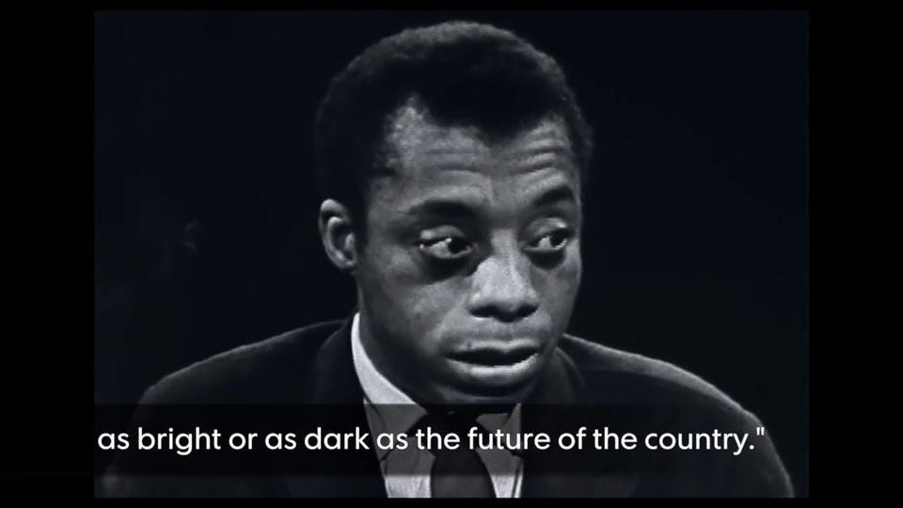
EXPECTED LEARNING OUTCOMES
GENERAL OBJECTIVES Understanding the concept Being acquainted with prose and author’s biography Understanding the idea Appreciate the language of the prose Developing LSRW Skills
SPECIFIC OBJECTIVES/ EXTENDED OBJECTIVES Understanding the concept Being acquainted with prose and author’s biography Understanding the idea Appreciate the language of the prose Developing LSRW Skills

Slide 3
INTRODUCTION TO THE STORY-TELLER
Kate Chopin (1850–1904) is an American writer best known for her stories about the inner lives of sensitive, daring women. Her novel The Awakening and her short stories are read today in countries around the world, and she is widely recognized as one of America’s essential authors.
Her short stories were well received in the 1890s and were published by some of America’s most prestigious magazines—Vogue, the Atlantic Monthly, Harper’s Young People, the Youth’s Companion, and the Century. A few stories were syndicated by the American Press Association. Many of her stories also appeared in her two published collections, Bayou Folk (1894) and A Night in Acadie (1897), both of which received good reviews from critics across the country who praised them for their graceful descriptions of the lives of Creoles, Acadians, African-Americans, and other people in Louisiana. Twenty-six of her stories are children’s stories—those published in or intended for children’s or family magazines—the Youth’s Companion and others. By the late 1890s Kate Chopin was well known among American readers of magazine fiction.

Slide 4
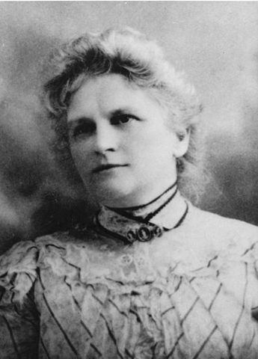

Slide 5
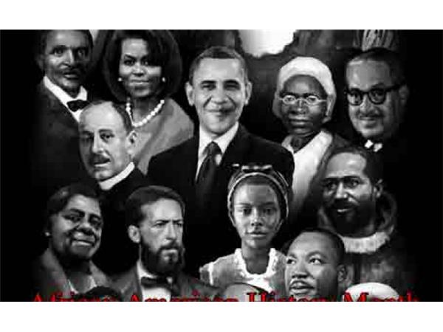
THEME OF THE STORY
In 'Désirée's Baby' by Kate Chopin, Désirée is left as a baby to Madame Valmont who has no children. She takes her in and loves her dearly. Armand Aubigny falls in love with Désirée when she is 18, and they are married. They have a baby whom they both adore. When he is a few months old, Madame Valmont notices that the baby's skin appears darker than when he was first born. Eventually, Armand realizes this too, and assumes that Désirée must be to blame, as her parentage is unknown. He is devastated and rejects both Désirée and the baby because he believes they are not white. Désirée takes the baby and walks into the bayou, never to return. At the end of the story, Armand finds a letter that says his mother, who died when he was 8 years old, was actually black, so it is Armand who is of black heritage

Slide 6
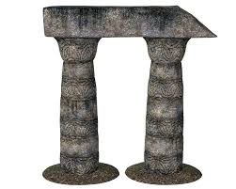
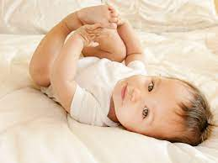

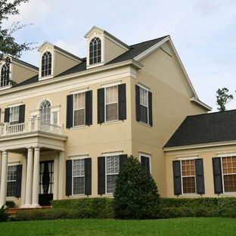
PAGE-56/57
*Madam Volmonde wanted to see Desiree and drove to L’ Abri
*Desiree’s origin
*Armand Aubigny saw Desiree and fell in love with her
*The passion in Armand
*Sad looking face of Desiree
*Old Monsieur Aubigny was very lenient and kind towards the black people

Slide 7
VOCABULARY
Strayed-moved off the correct track
Of her own accord-voluntarily
Obscure-unknown
Corbeille—a graceful looking basket of fruits or flowers
Shudder-tremble
Stuccoed-plastered house
Pall-cloth
stocking - a women's garment, typically made of translucent nylon or silk, that fits closely over the foot
Home Assignment:
Write the word meaning.
Write a note on ‘Desiree’s origin’ in about 50 words.

Slide 8
THANK YOU
ODM EDUCATIONAL GROUP

