Slide 1

WELCOME TO ODM ONLINE CLASS
CLASS-UKG
SUBJECT-CONVERSATION
T0PIC-CHAPTER-4
( I can count )

Slide 2
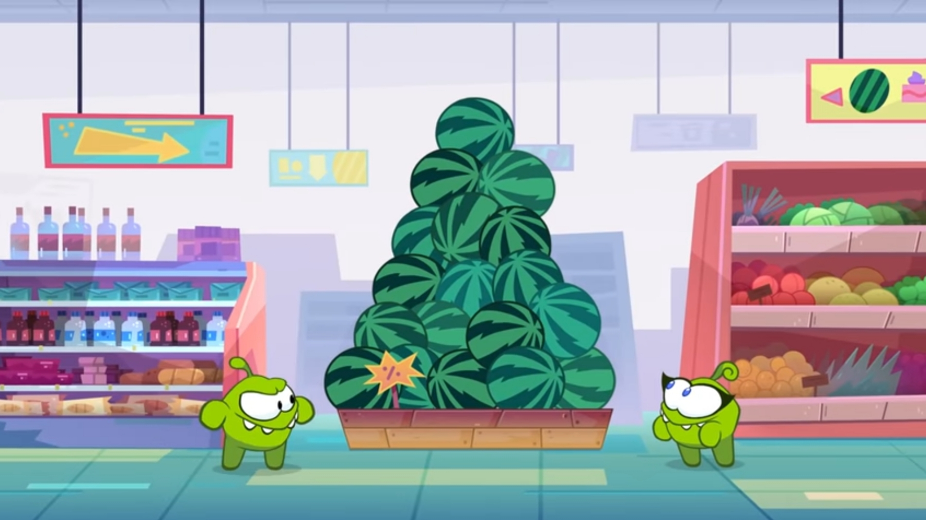
COUNT THE WATERMELONS
18

Slide 3
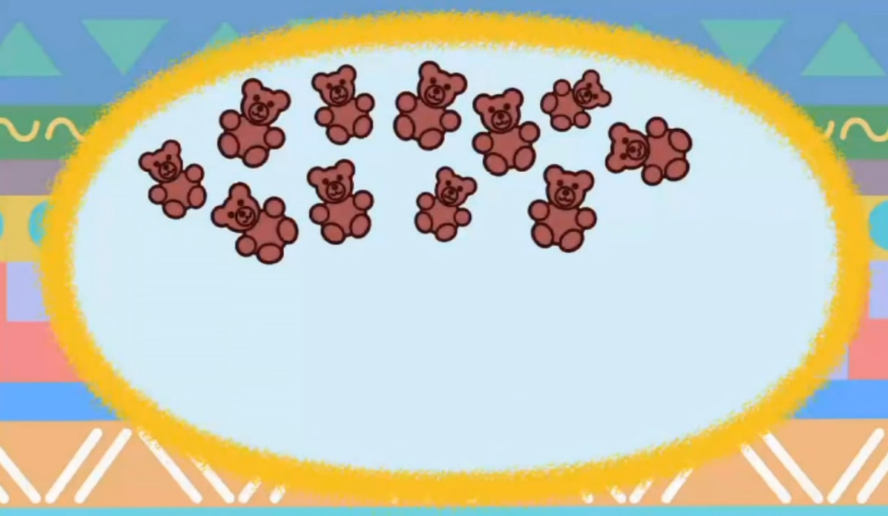
COUNT THE TEDDIES
11

Slide 4
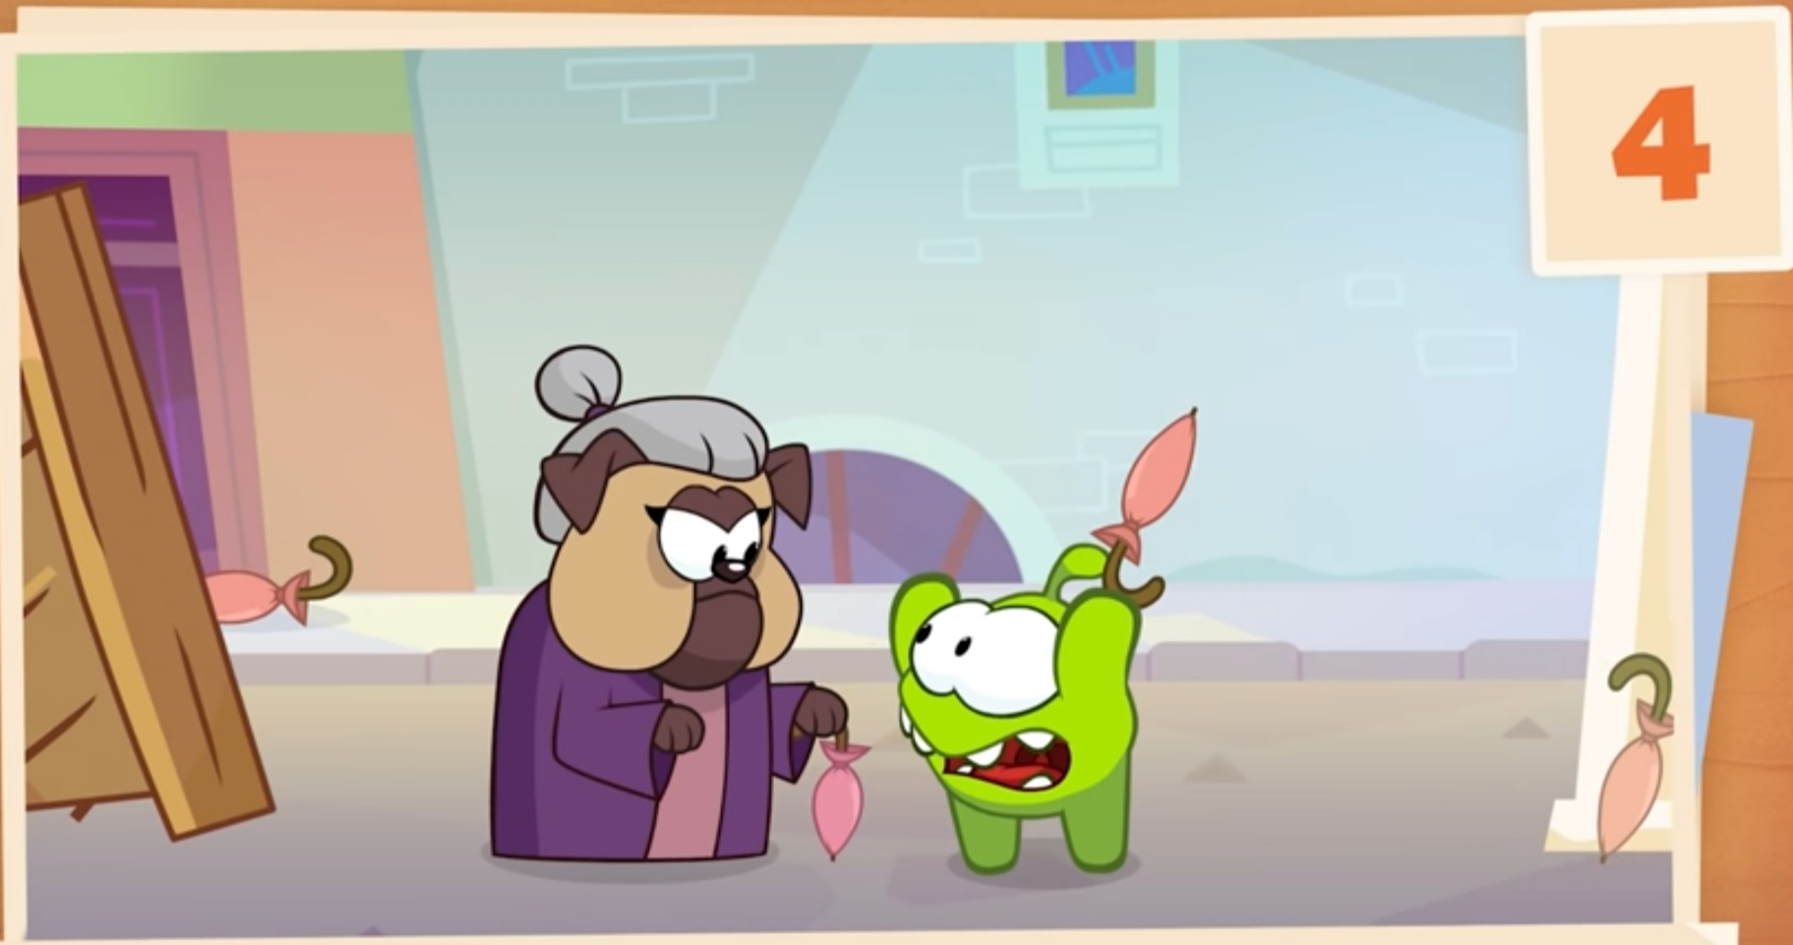
COUNT THE UMBRELLAS
4

Slide 5
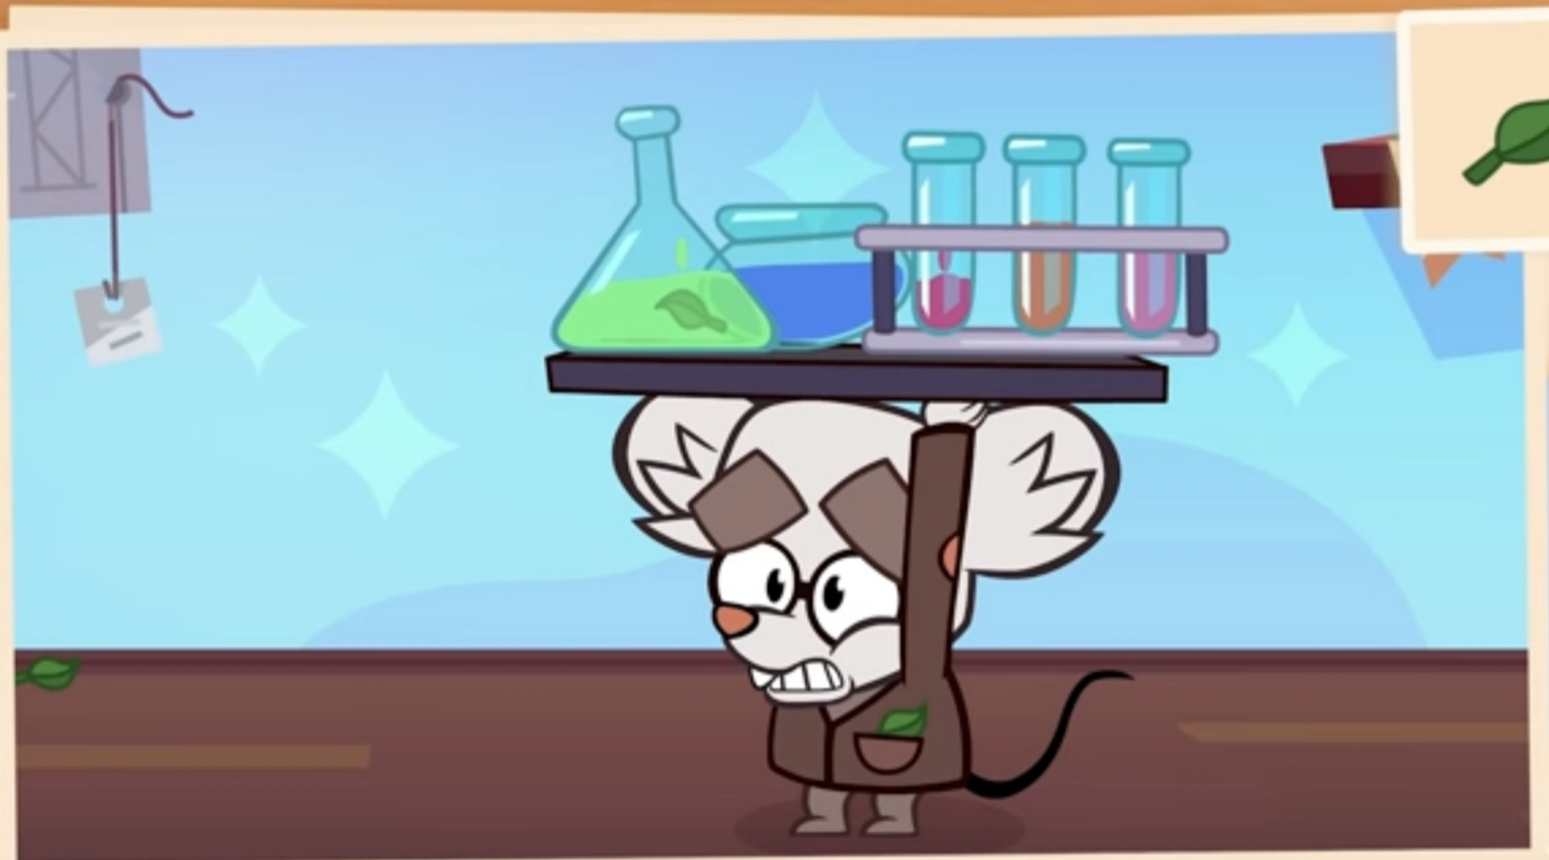
COUNT THE LEAVES
3

Slide 6

COUNT THE STARS
20

Slide 7
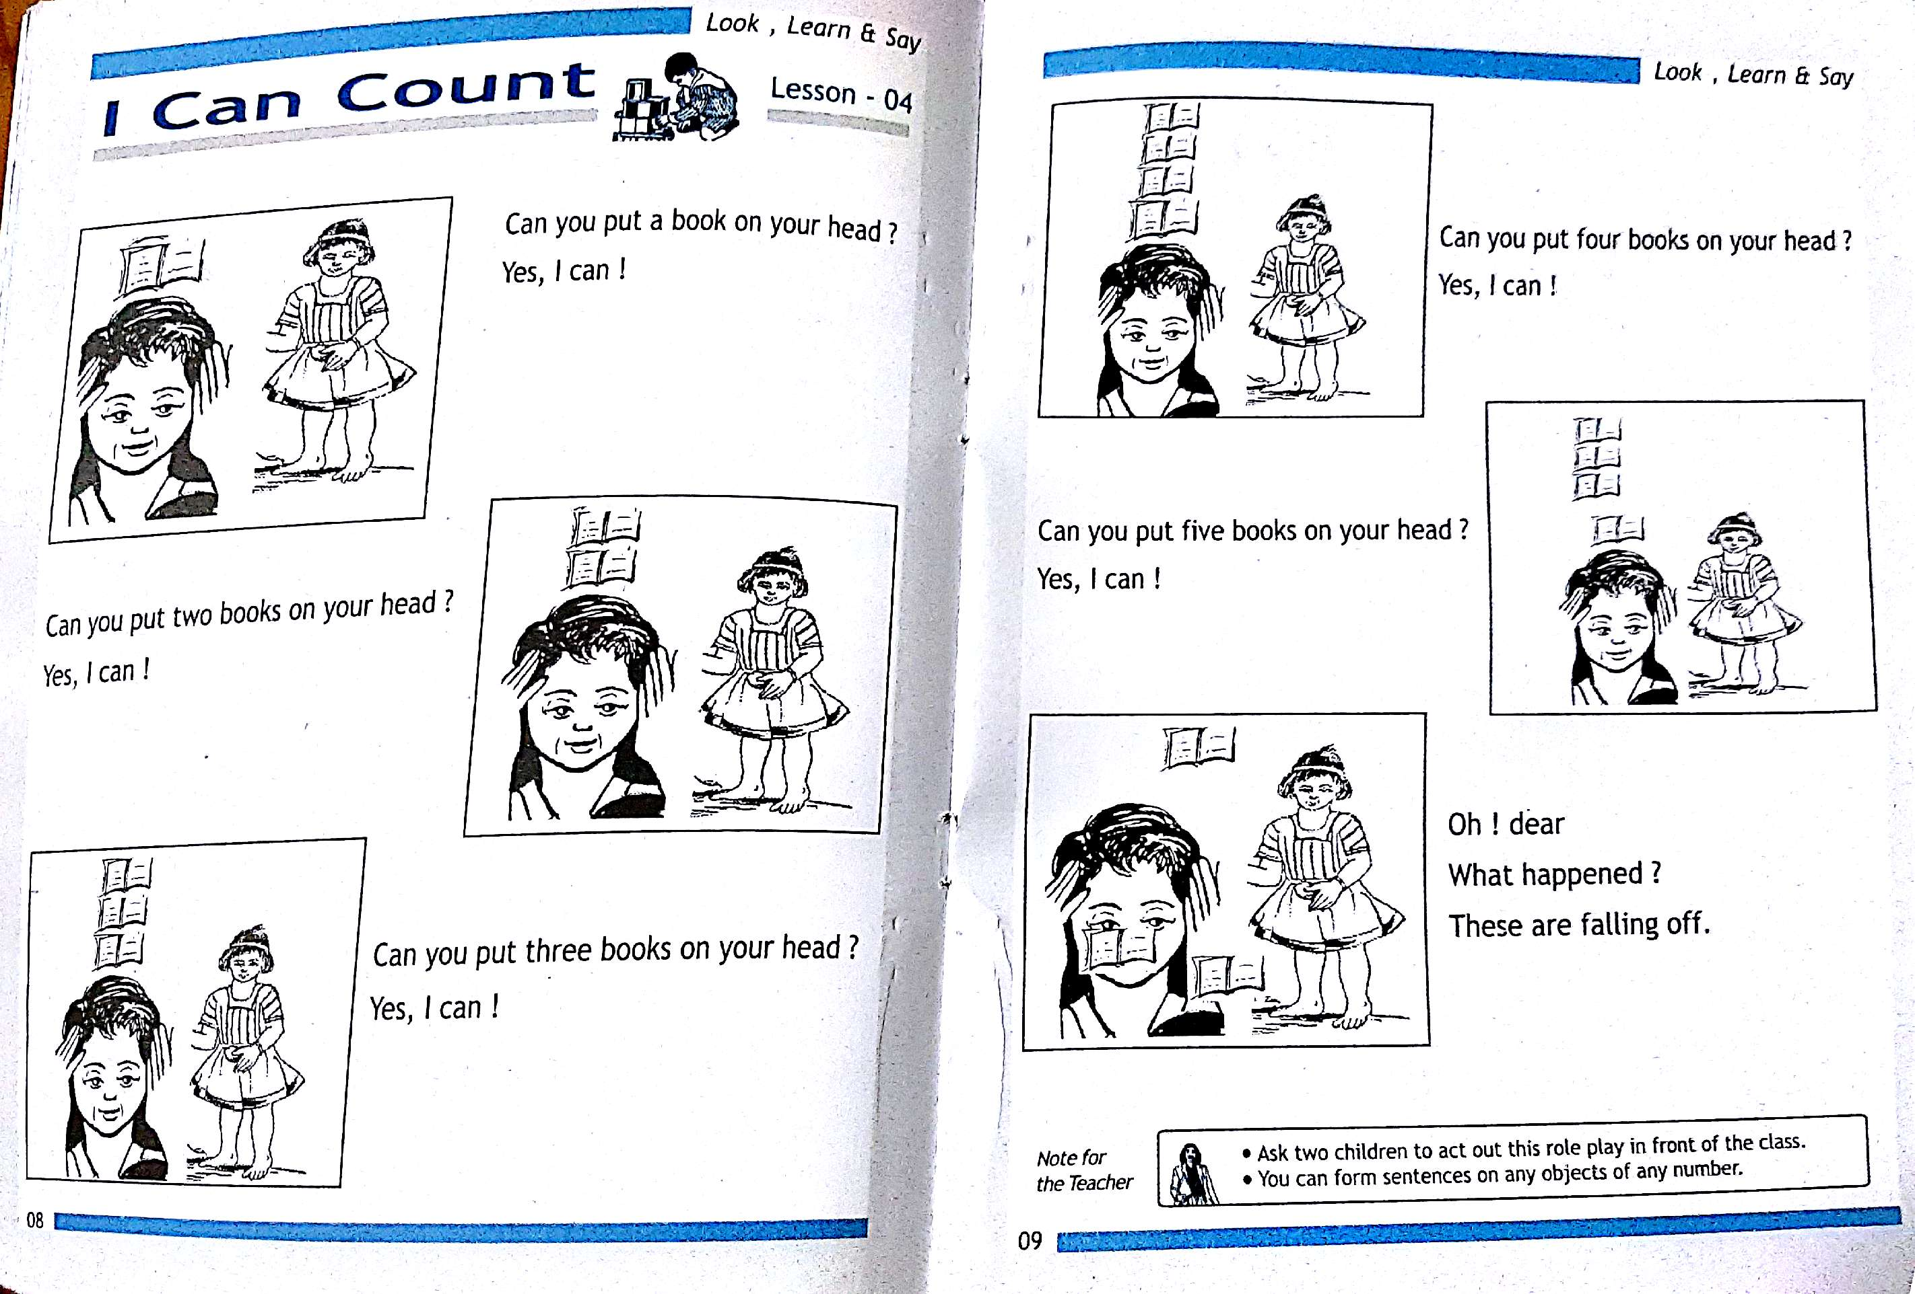
HOME ASSIGNMENT
CW
27/7/21

Slide 8


THANKING YOU
ODM EDUCATIONAL GROUP

