Slide 1

WELCOME TO ODM ONLINE CLASS
CLASS-UKG
SUBJECT-CONVERSATION
T0PIC-CHAPTER-4
( I can count )

Slide 2
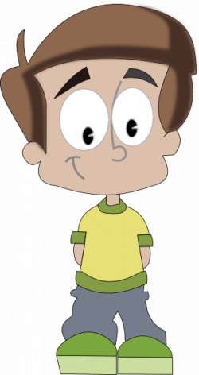
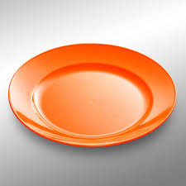
CAN YOU COUNT THE BEADS ?
12

Slide 3
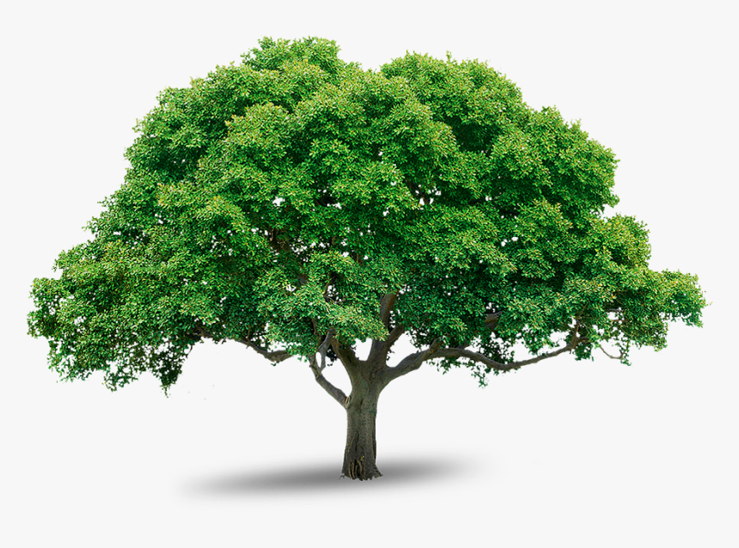
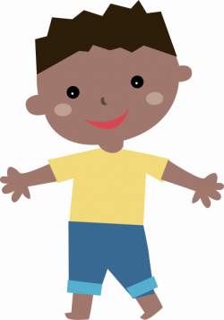

CAN YOU COUNT THE LEAVES ?
15

Slide 4


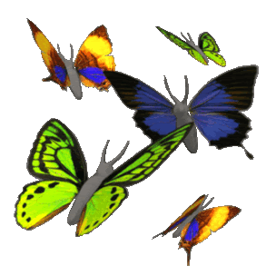
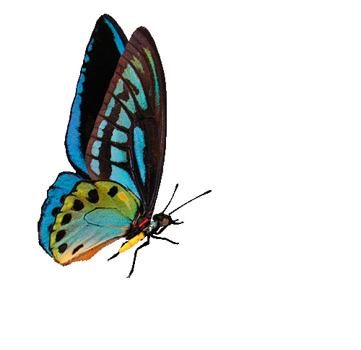
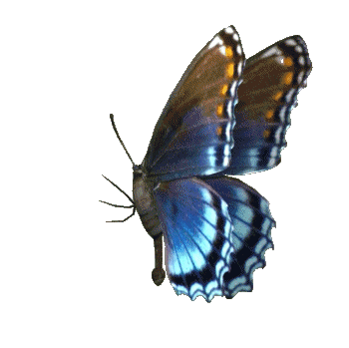
CAN YOU COUNT THE BUTTERFLIES THAT ARE FLYING ?
11

Slide 5
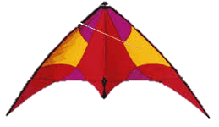

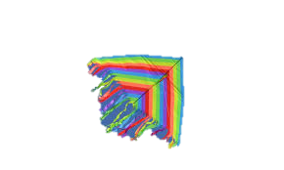

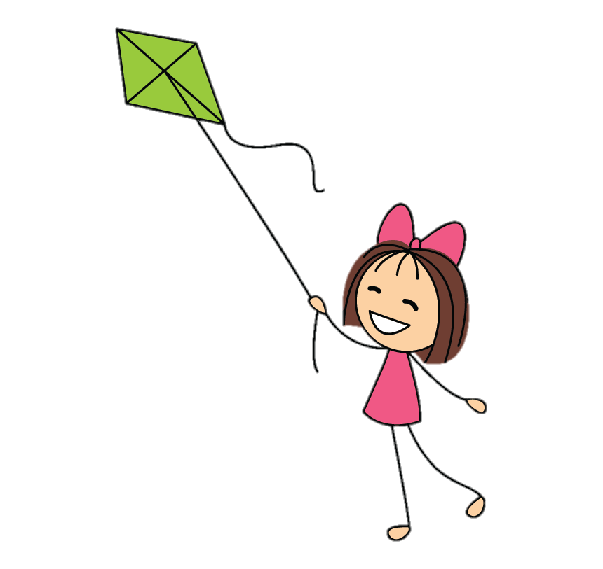
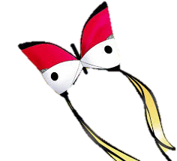
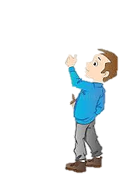
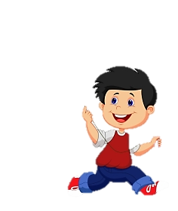
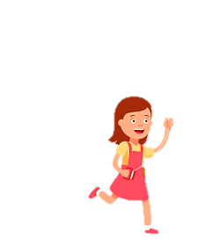
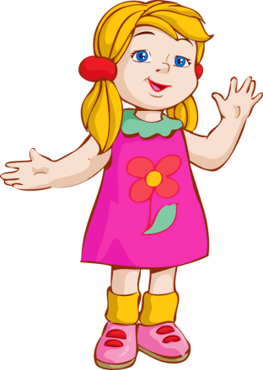
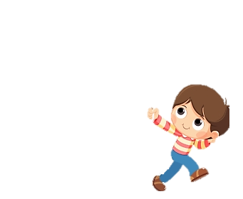


CAN YOU COUNT THE KITES ?
6
LISHA
RIKU
RIKI
MONU
NISHA
CHIKU

Slide 6
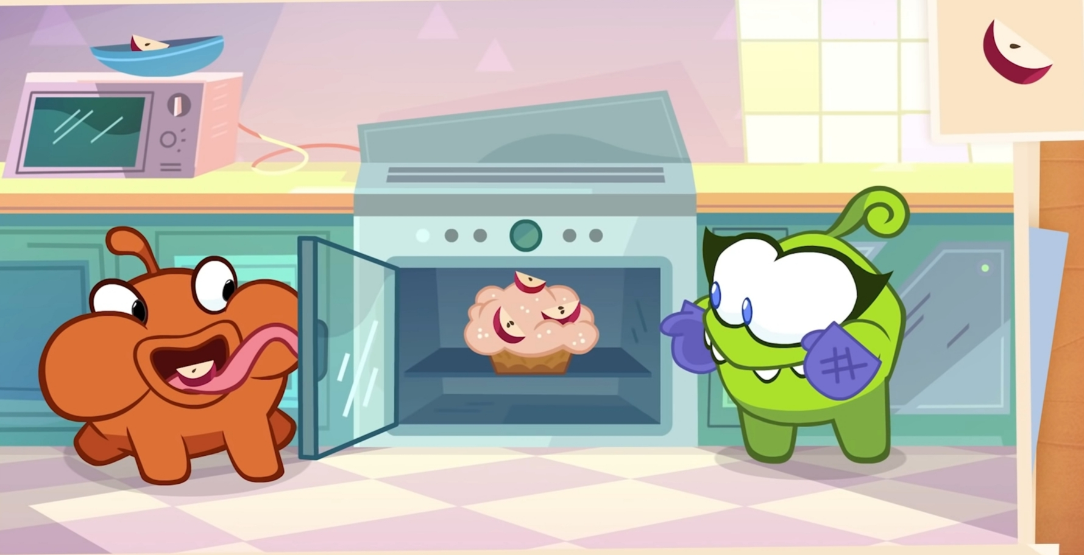
CAN YOU COUNT THE APPLES ?
5

Slide 7
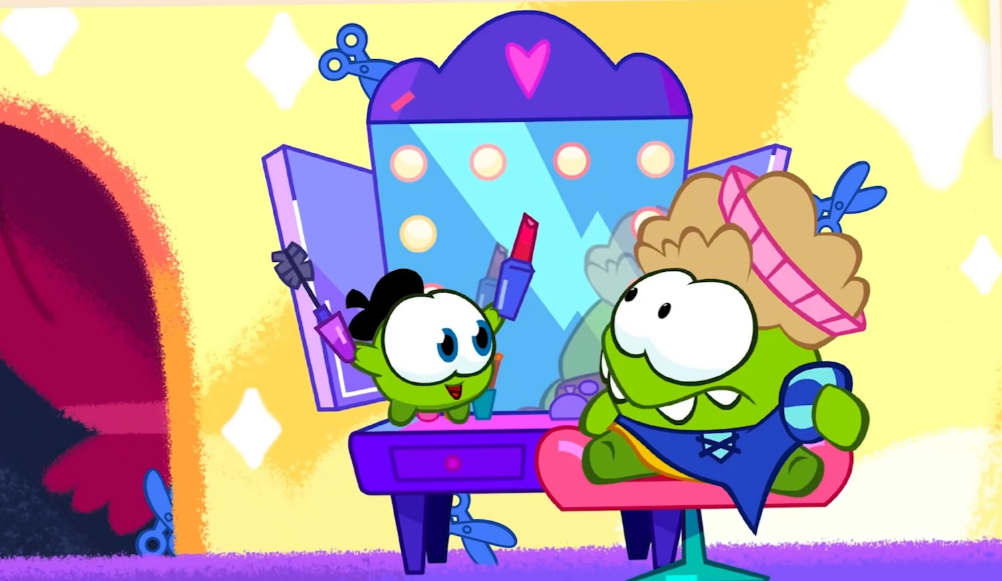
CAN YOU COUNT THE SCISSORS?
4

Slide 8
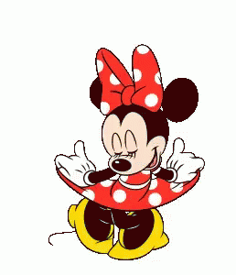

THANKING YOU
ODM EDUCATIONAL GROUP

