Slide 1
WELCOME TO ONLINE CLASS
CLASS : UKG
SUBJECT : ENGLISH
Chapter : 6 (ACTION WORDS)

Slide 2

ACTION WORDS

Slide 3
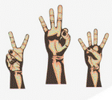
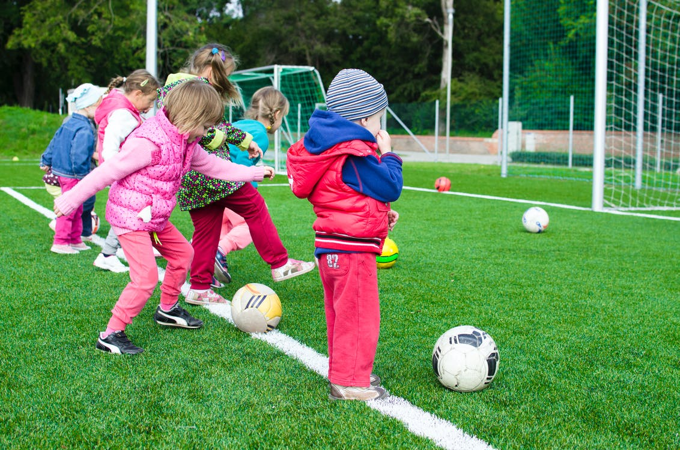
Counting
Playing

Slide 4
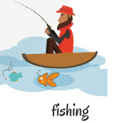


Slide 5
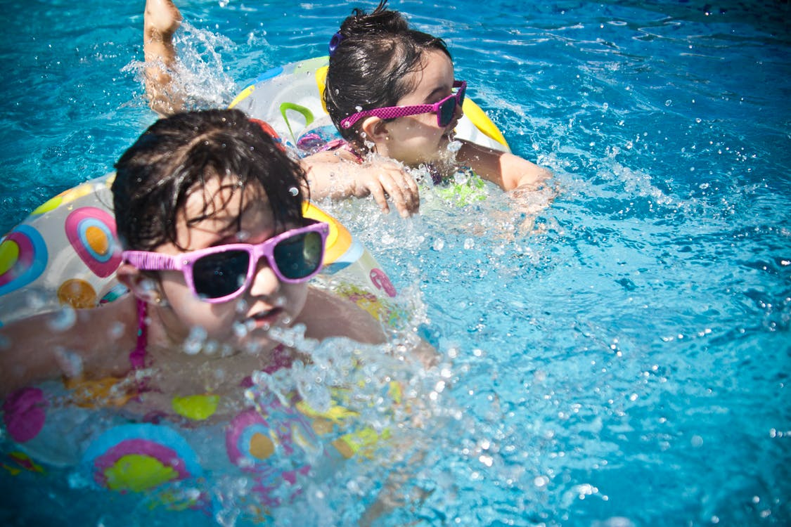
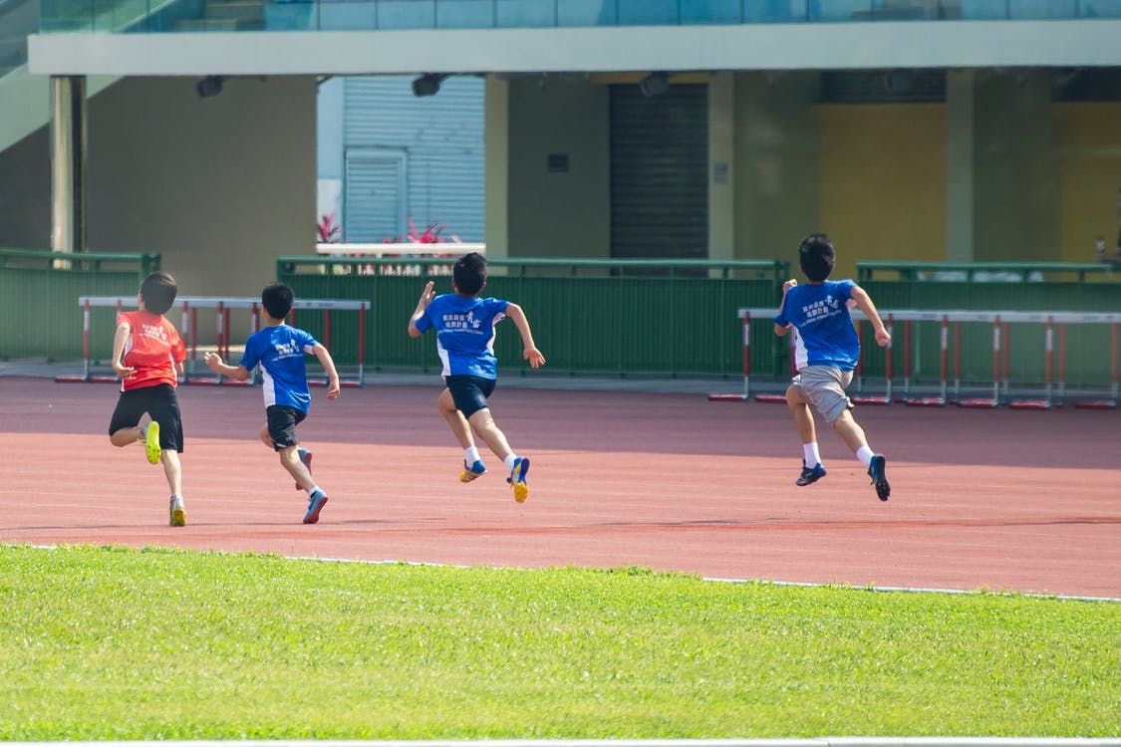
Swiming
Running

Slide 6
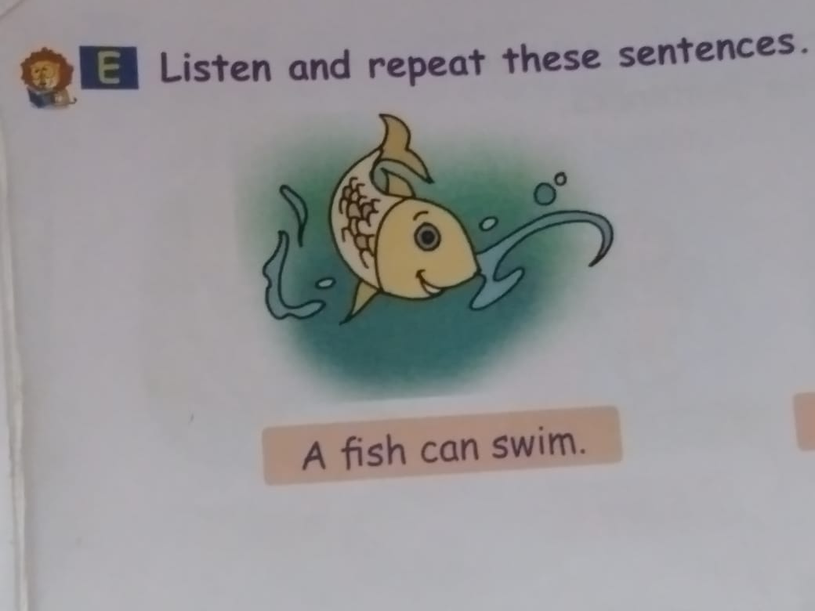

Slide 7
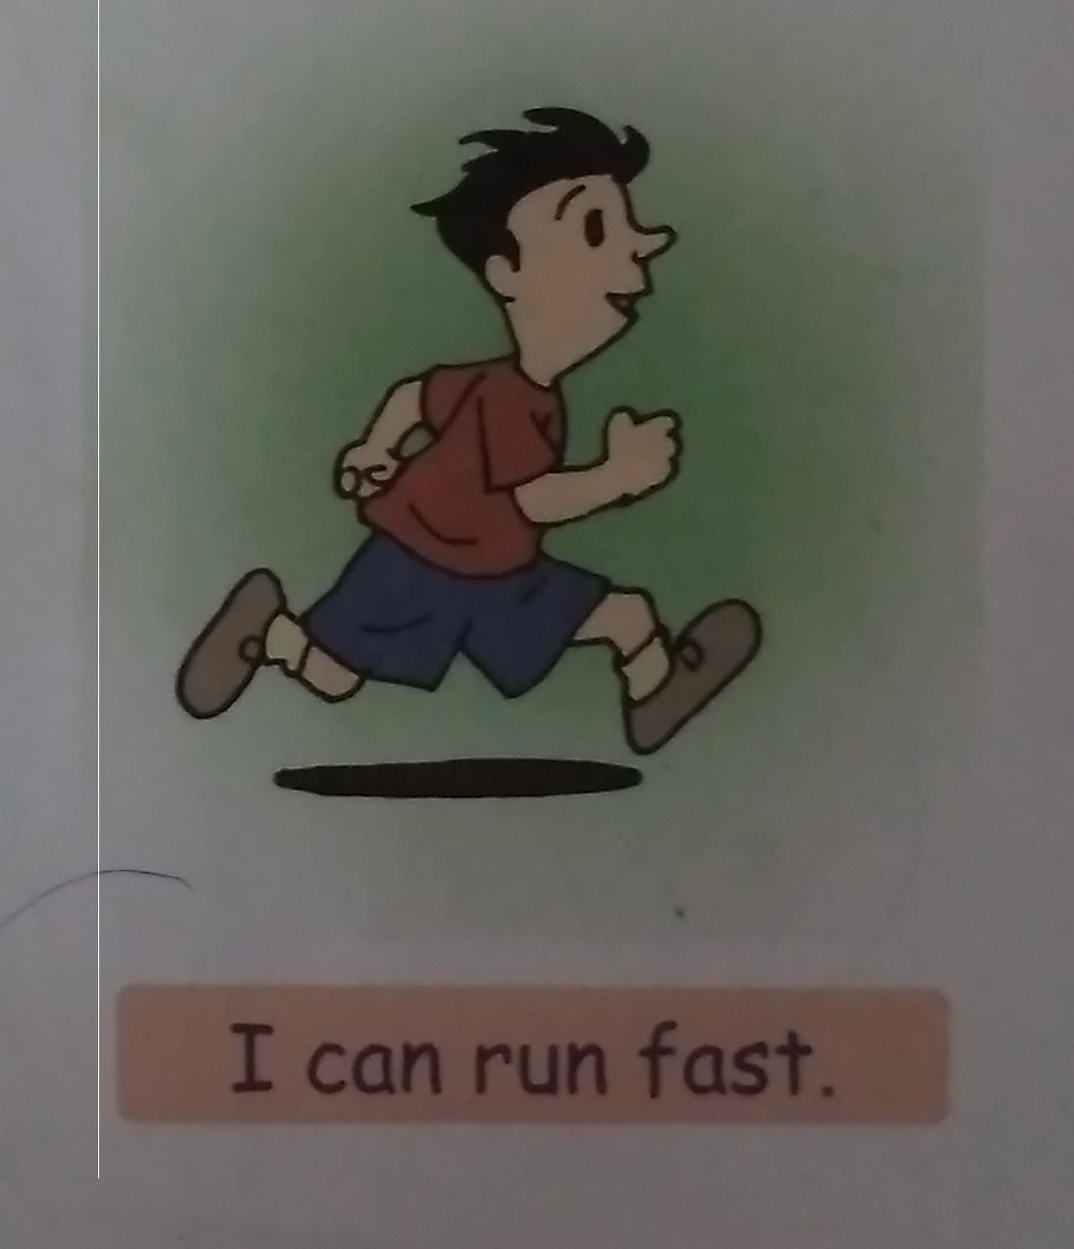

Slide 8
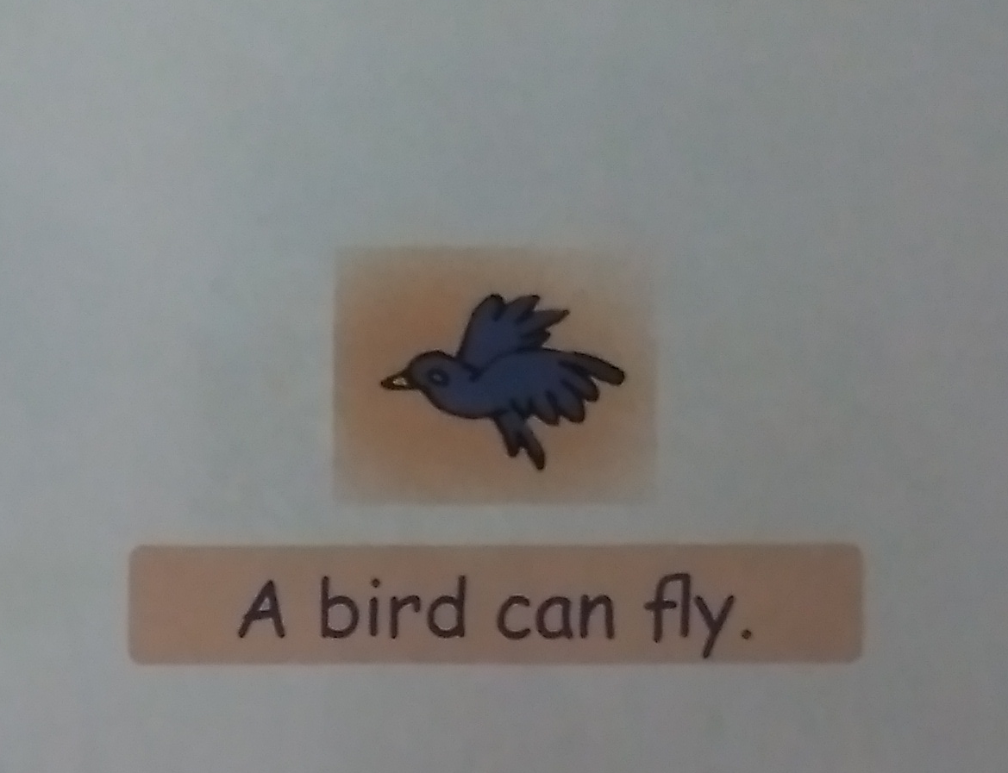

Slide 9
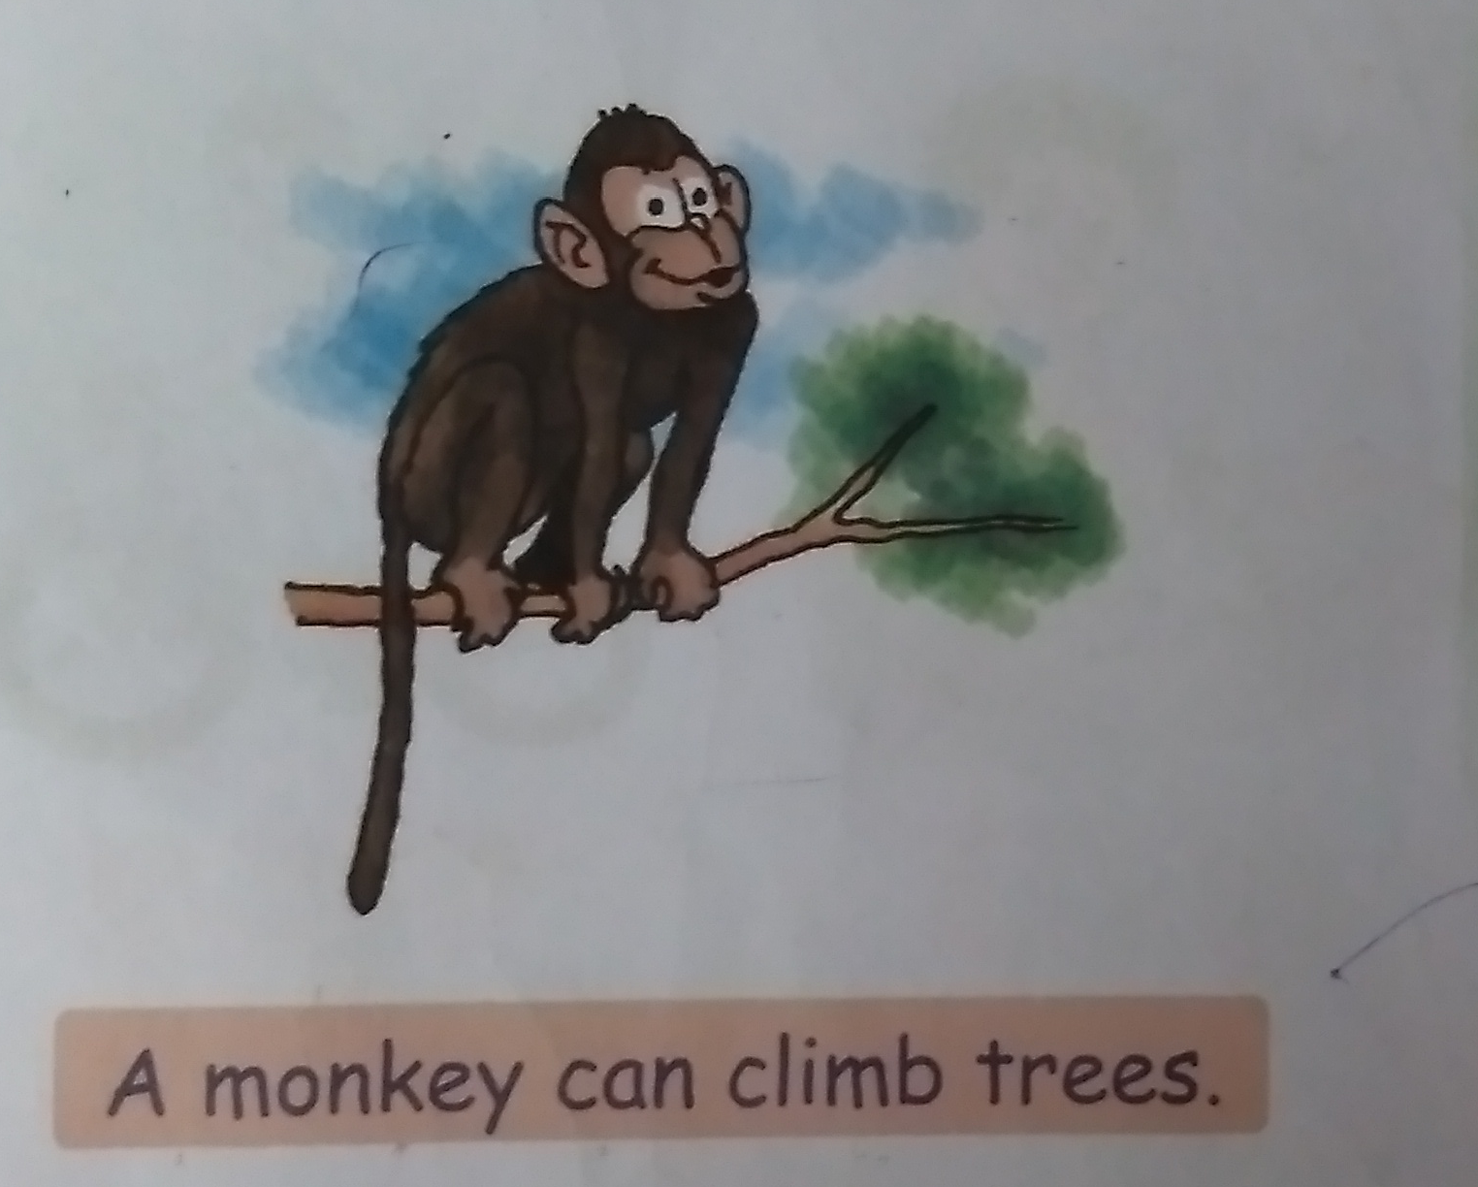

Slide 10
CLASS ASSIGNMENT (Note book work)
Complete the sentences using different action words given below :
(dance, run , fly ,swim climb, jump)
A fish can ______
A bird can ______
A monkey can ____ a tree
I can ____ fast
A frog can _____

Slide 11

THANKING YOU
ODM EDUCATIONAL GROUP

