Slide 1


CLASS : UKG
SUBJECT : ENGLISH
CHAPTER NUMBER : 8
CHAPTER NAME : “ ow – sound words “
TOPIC : REVISION

Slide 2
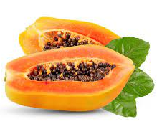
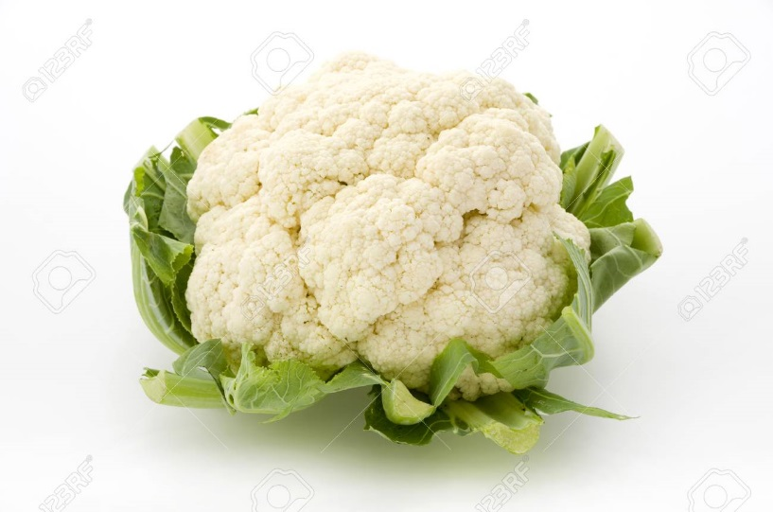
CLASS ASSIGNMENT : COMPLE THE SENTENCES
Dt. 2/12/2021
Is this a papaya ?
_________ it is.
Is this a pumpkin?
No, it isn’t.
_______ cauliflower.

Slide 3

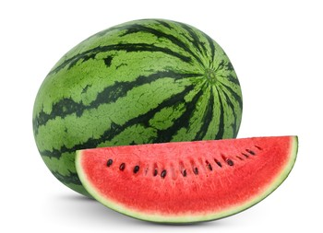
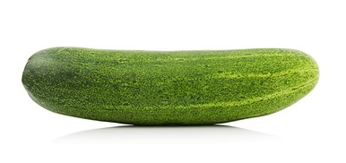
This is a watermelon.
Is it a fruit?
Yes, ________
This is a cucumber.
Is it a fruit?
No, it isn’t.
It’s a ____________

Slide 4
Revision ( Re-arrange the jumbled words)
Dt. 02/12/2021
APPAYA
GAPESR
OWND
OWN

Slide 5

HOME ASSIGNMENT : Write 5 “ow” sound words in your note book
OW

Slide 6
THANKING YOU
ODM EDUCATIONAL GROUP

