Slide 1


CLASS : UKG
SUBJECT : ENGLISH
CHAPTER NUMBER : 7
CHAPTER NAME : “ P – sound words “
TOPIC : USES OF He/ She/ It

Slide 2



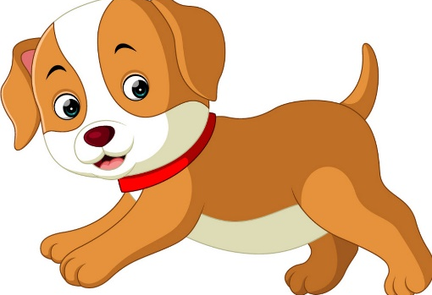
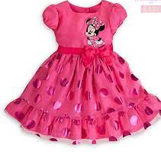
Dt. 18/11/2021
Uses of He/ She/ It
We use ‘He’ for boys.
We use ‘She’ for girls.
We use ‘It’ for objects /animals.
It
He
She

Slide 3



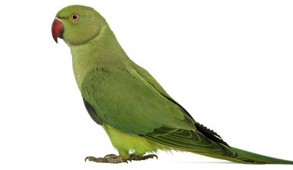
DT. – 18.11.2021
CLASS ASSIGNMENT
Fill in He/She/It to complete the sentences.
…………………. is a boy.
………………… is a girl.
……………… is a doctor.
……………. is a parrot .

Slide 4
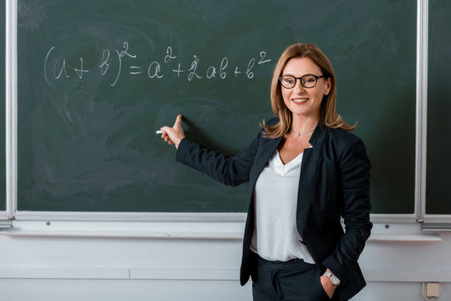
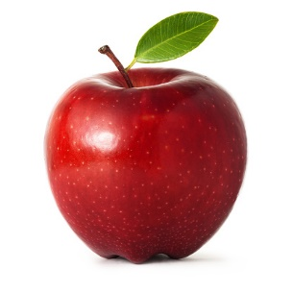
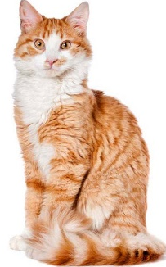
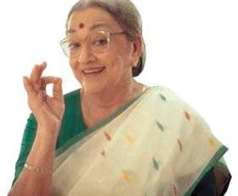
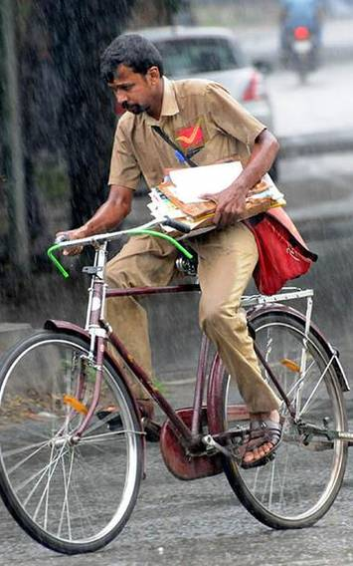
………….is a teacher.
………….is an apple.
7. ……………is a cat.
……………is my grandmother.
9. ……………..is a postman.

Slide 5
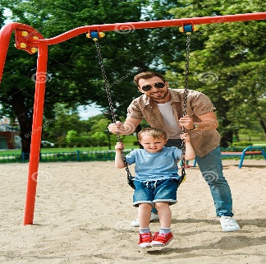
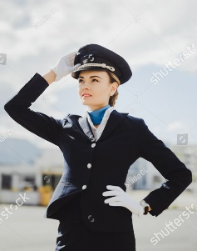
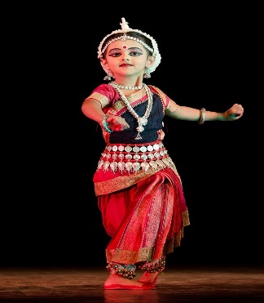
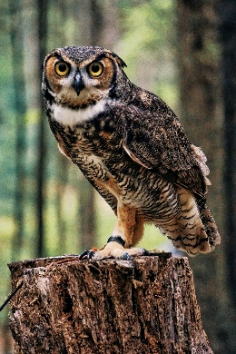
HOME ASSIGNMENT.
Fill in He/She/It :
This is my father. …………. takes me to park.
2. This is my aunt. …………..is a pilot.
This is my sister. ……………is a dancer.
4. ………..is an …………….

Slide 6
THANKING YOU
ODM EDUCATIONAL GROUP

