Slide 1

WELCOME TO ONLINE CLASS
CLASS : UKG
SUBJECT : ENGLISH
CHAPTER : 7
TOPIC : P SOUND WORDS

Slide 2
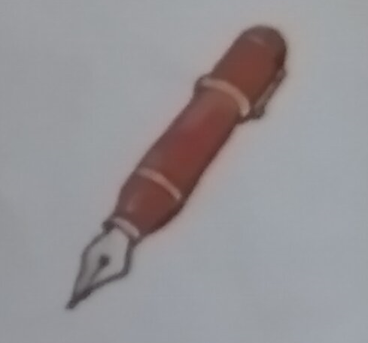
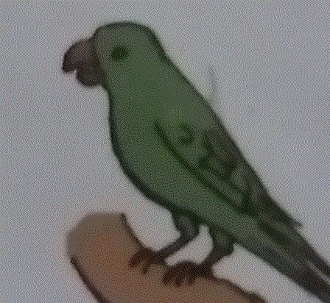
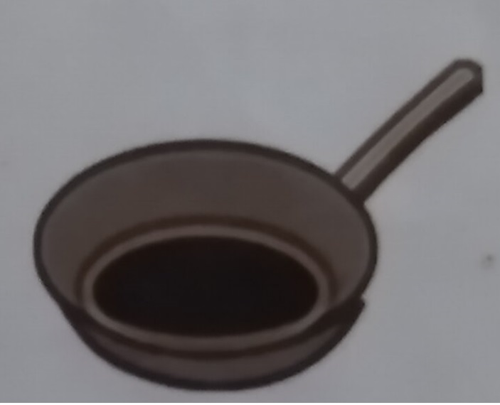
‘P’ SOUND WORDS (RE-CAP)
PARROT
PEN
PAN

Slide 3
LETS BLEND THE FOLLOWING WORDS
pet
pan
pup
pen
park
play

Slide 4
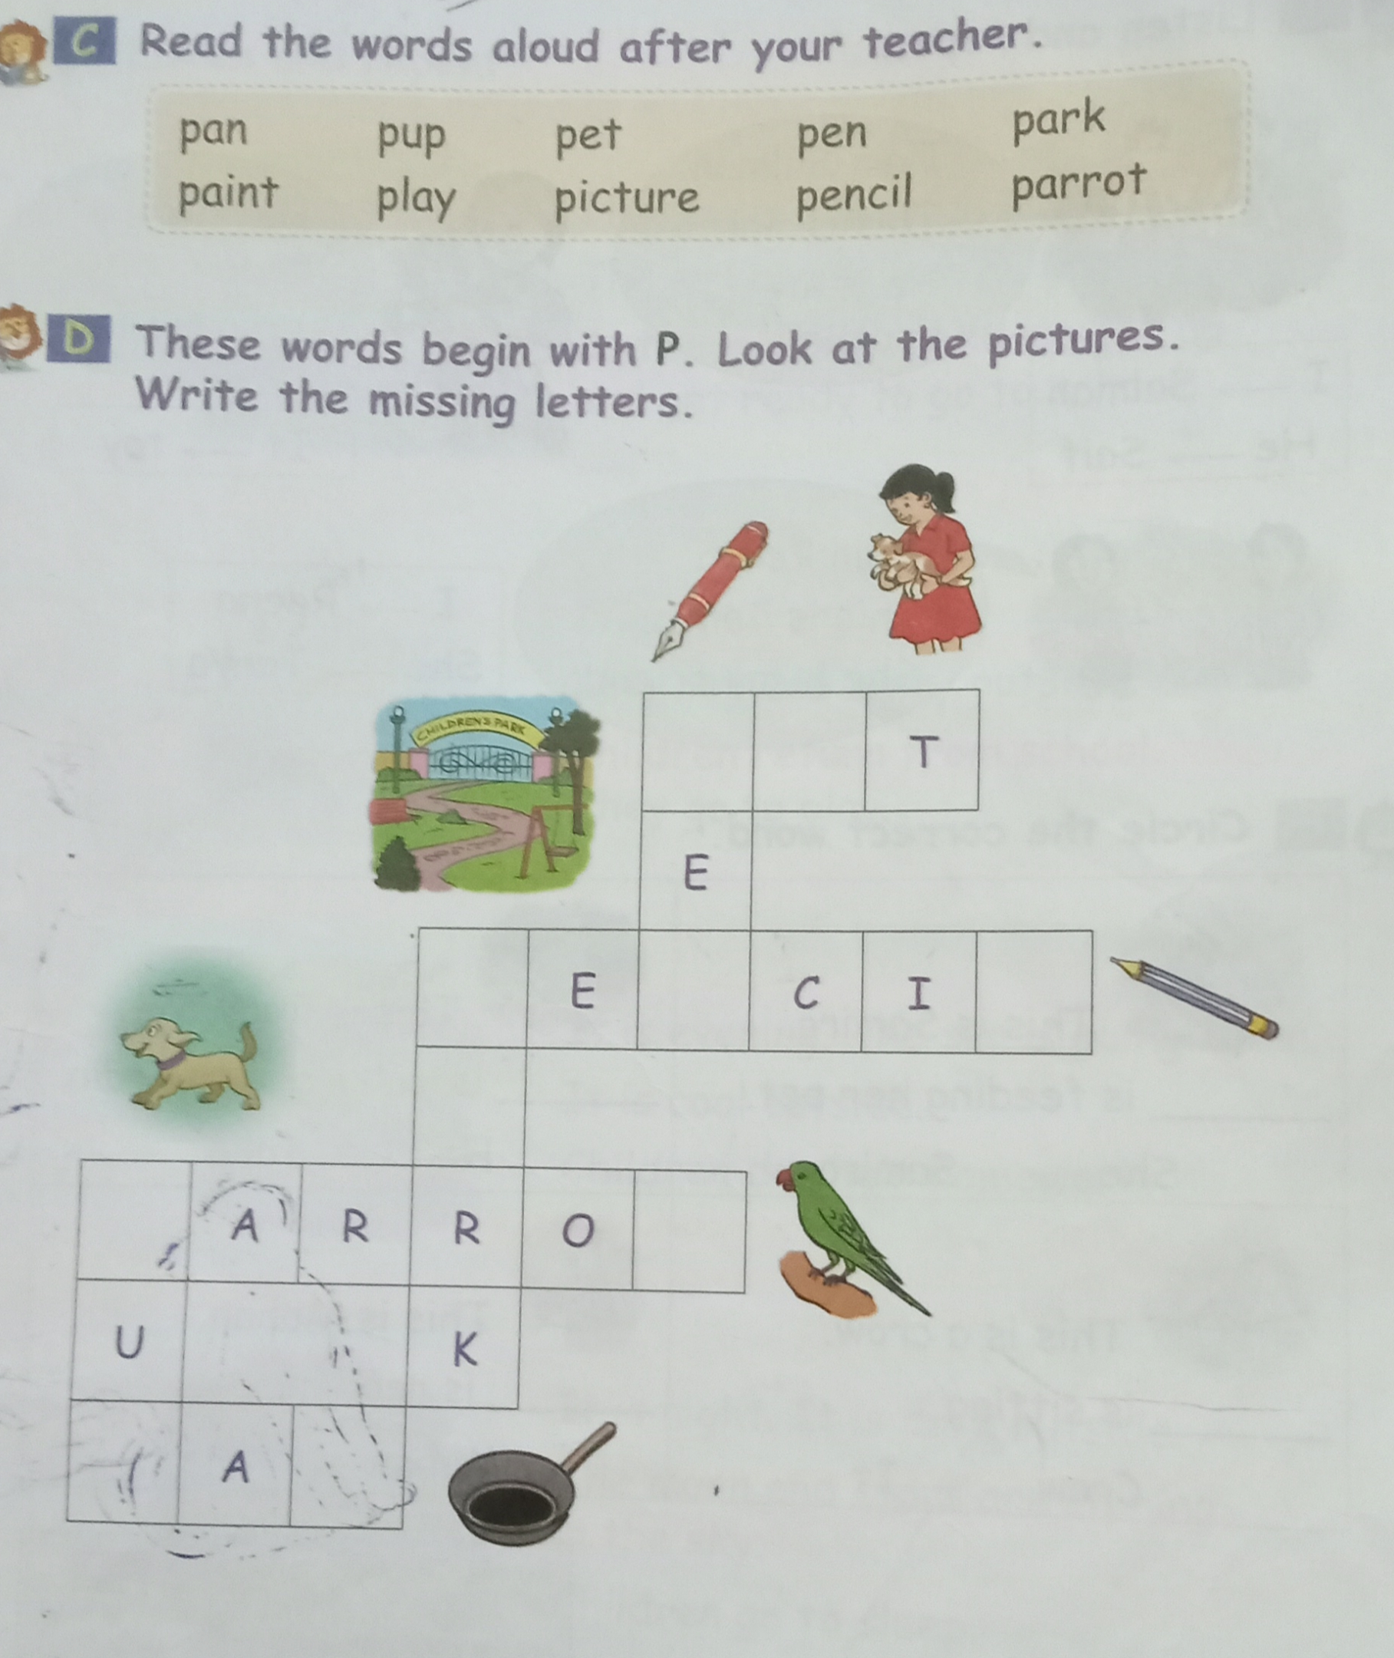
CLASS ASSIGNMENT ( Let’s read and do bk page -37

Slide 5
HOME ASSIGNMENT
LET’ S WRITE IN NOTE BOOK
P + an = P + in =
P + et = p + aint =
P + eon = p + arrot =
PP

Slide 6

THANKING YOU
ODM EDUCATIONAL GROUP

