Slide 1

WELCOME TO ONLINE CLASS
CLASS : UKG
SUBJECT : ENGLISH
CHAPTER : 3 ( ‘oa’ sound words)
TOPIC : Blending of ‘oa’ sound.

Slide 2

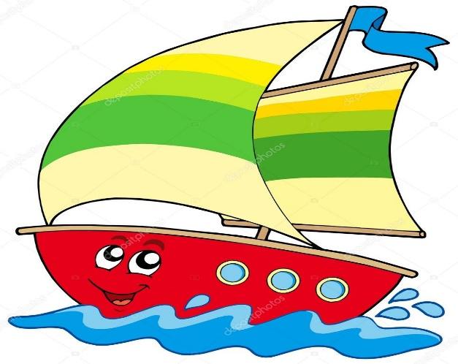
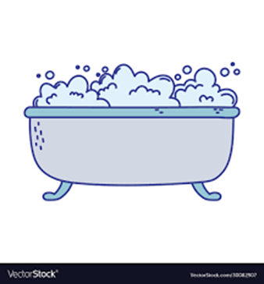
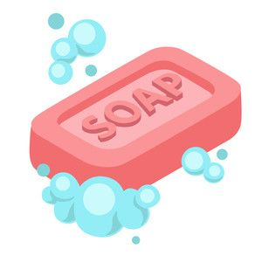
LET’S RECALL THE WORDS
coat
boat
foam
soap

Slide 3
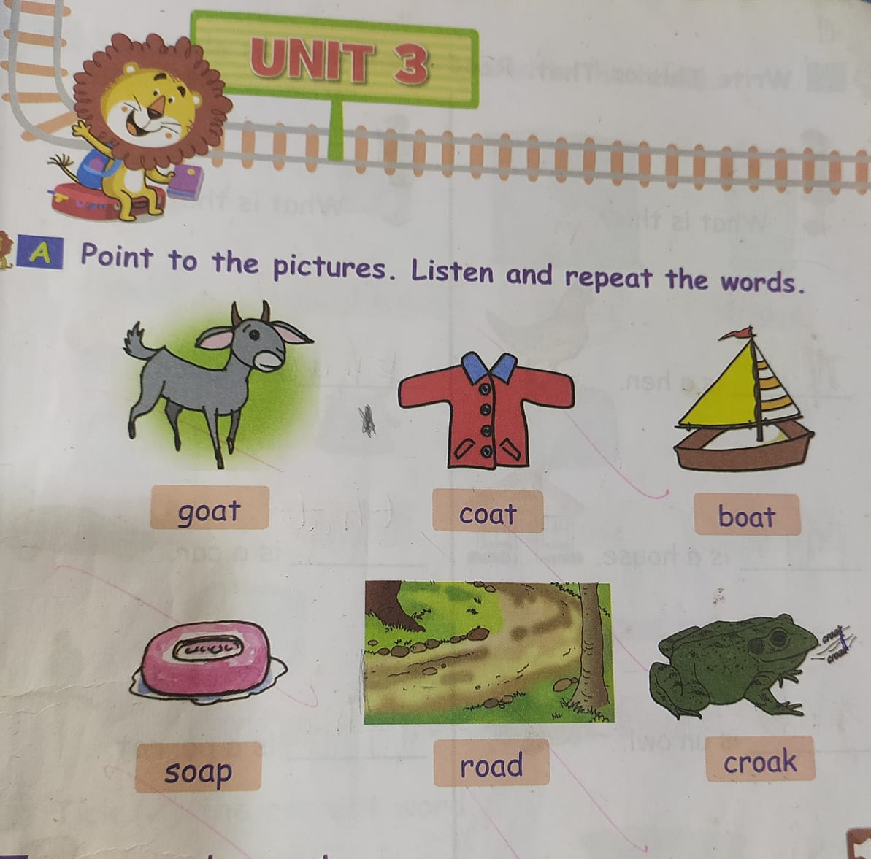

Slide 4

LET’S BLEND THE WORDS
goat
boat

Slide 5
road
soap
foam

Slide 6
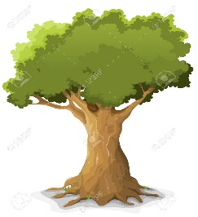
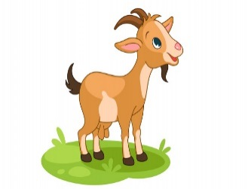
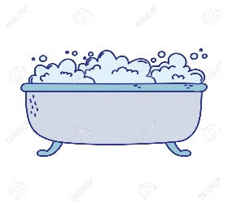
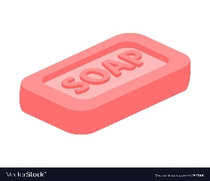
MATCH THE FOLLOWING
soap
oak
foam
goat

Slide 7
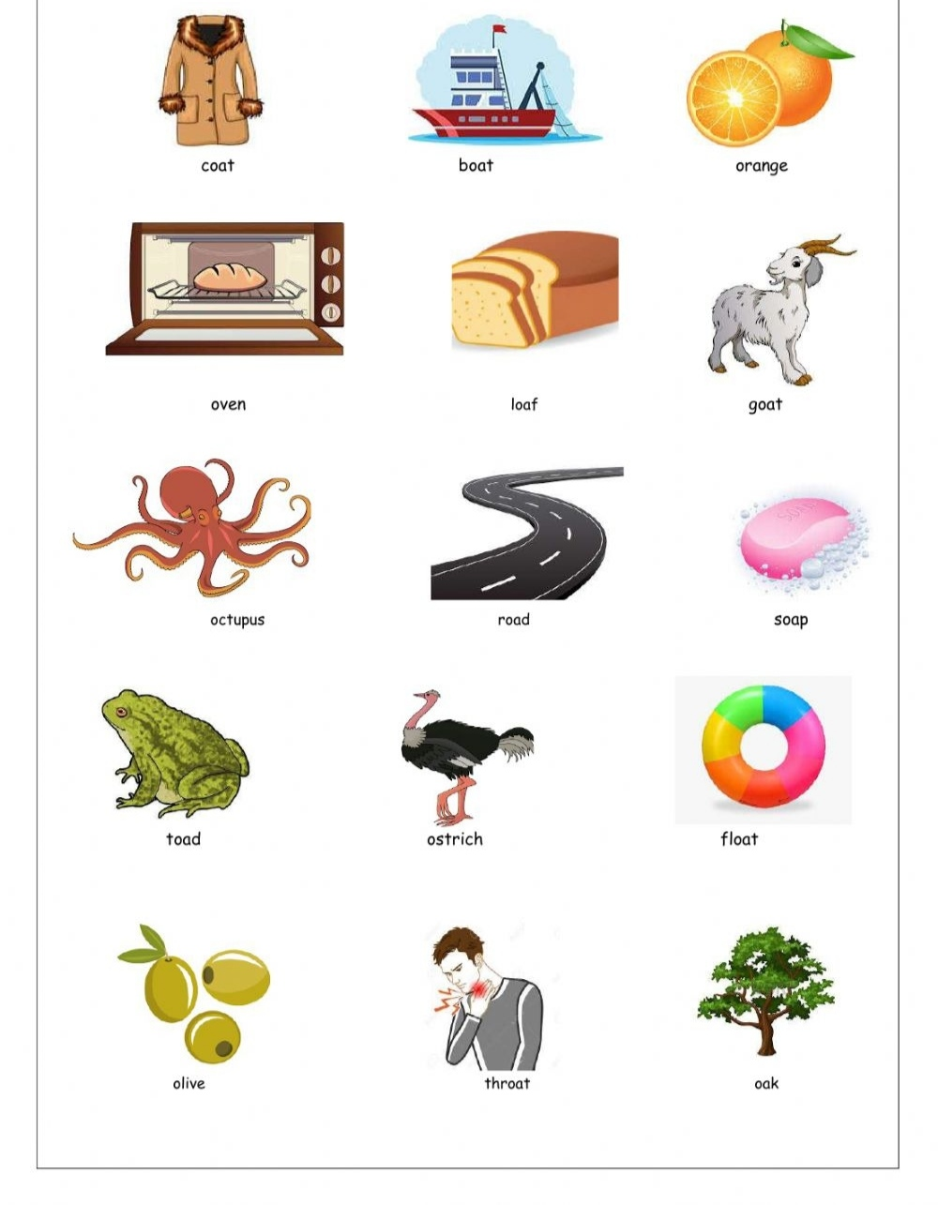
Identify the ‘oa’ sound pictures and learn the spelling from the given worksheet. ( Home assignment)

Slide 8

THANKING YOU
ODM EDUCATIONAL GROUP

